Slide 1

The Importance of Building Reps
The Foundation of a Strong Union & Local
Mike Hennessey, Director of Field Services

Slide 2
Why Building Representatives Matter
What are Building Reps?
The union's eyes and ears in each worksite.
The first point of contact for members.
A trusted source of information.
A bridge between members and local leadership.
Leaders who help identify and solve workplace issues early.
What are consequences of not having Building Reps?
Information moves slowly and poorly.
Member concerns may go unheard.
Leadership becomes disconnected from worksites.
Organizing efforts become more difficult.

Slide 3
The Building Rep’s Role
Core Responsibilities
Welcome new employees and give membership ask.
Share union information and updates.
Listen to member concerns.
Identify workplace issues before they become major problems.
Encourage participation in union activities.
Help build solidarity among staff.
Connect members with local officers when assistance is needed.
Building Reps Are Not Expected To:
Handle grievances.
Have all the answers.
Just be a “mailbox stuffer”.
Their role is to connect, communicate, and engage.

Slide 4
Building Representatives Increase Union Strength
Strong Building Rep Networks Lead To:
Higher membership engagement.
Increased participation in actions and campaigns.
More accurate understanding of workplace concerns.
Faster response to emerging issues.
Greater member trust in union leadership.
A union is only as strong as its connection to members in every building.

Slide 5
Building Representatives Help Solve Problems Early
Consider This Scenario: A new scheduling issue affects teachers in one school.
Without a Building Rep:
Members complain privately.
Rumors spread.
Leadership learns about the issue weeks later or not at all.
“What’s the Union doing about this?”
With a Building Rep:
Concerns are identified immediately.
Accurate information is gathered.
Leadership can respond quickly.
Members feel supported and informed.

Slide 6
Building Representatives Help Solve Problems Early
Consider This Scenario: A petition is being started for all members and employees to sign.
Without a Building Rep:
The petition doesn’t get into every building.
Employees aren’t informed about the petition or asked to sign.
If petitions are signed, they don’t make it back to the local leadership.
“What’s the Union doing about this?”
With a Building Rep:
Petitions are sent to each rep and therefore each building.
Reps can have 1-on-1 conversations to explain petition and ask for signatures.
Petitions can be presented to entire staff at meetings or faculty senate.
Petitions are returned to local by deadline.

Slide 7
The Best Personality Traits for Building Representatives
Effective Building Reps Are:
Approachable-Members feel comfortable bringing concerns to them.
Trustworthy-They maintain confidentiality and credibility.
Positive-They focus on solutions rather than complaints.
Reliable-Members know they can count on them.
Good Listeners-They listen to understand before responding.
Respectful-They work well with diverse personalities and viewpoints.
Organized-They follow through on commitments and communications.
The best building rep is not necessarily the loudest person in the building, but the person who members trust.

Slide 8
Recruiting Strong Building Representatives
Look For Individuals Who:
Have positive relationships with coworkers.
Demonstrate professionalism.
Show concern for fellow employees.
Are respected by peers.
Have leadership potential.
Avoid Focusing Solely On:
Seniority
Popularity
Job title
Focus on influence and trust.

Slide 9
Every Building Needs Representation
Goal:
One designated building representative in every worksite.
Even Better:
A team approach.
  One primary representative and one alternate representative
  Representation from different employee groups when possible
  One rep for each end or each floor of a building
  Split duties between reps
This ensures continuity and broader member engagement.

Slide 10
Creating a Local Communication Chain
Step 1: Local Officers
President, Vice President, Secretary, Treasurer, and other leaders.
⬇
Step 2: Building Representatives
One or more representatives in every worksite.
⬇
Step 3: Members
Every educator and school employee.
This creates a structured and reliable communication network.

Slide 11
Communication Chain Example
Leadership Sends Information
Local President
⬇
Building Representatives
⬇
Members in Each Building
Information Flows Back Up
Local Leadership
⬆
Building Representatives
⬆
Members
Communication must flow both directions.

Slide 12
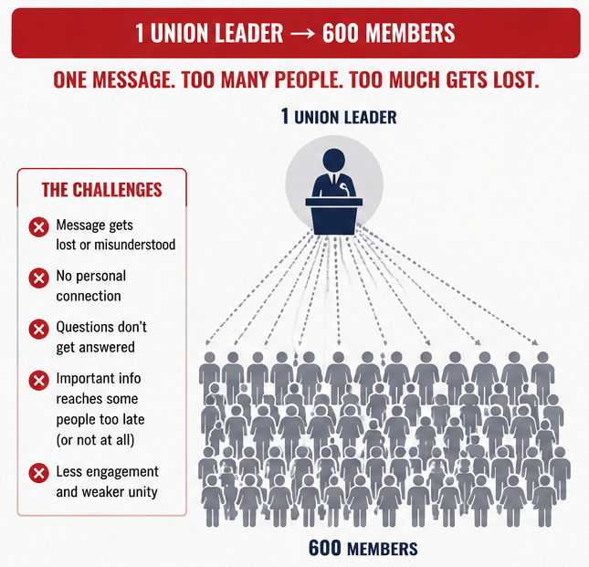

Slide 13
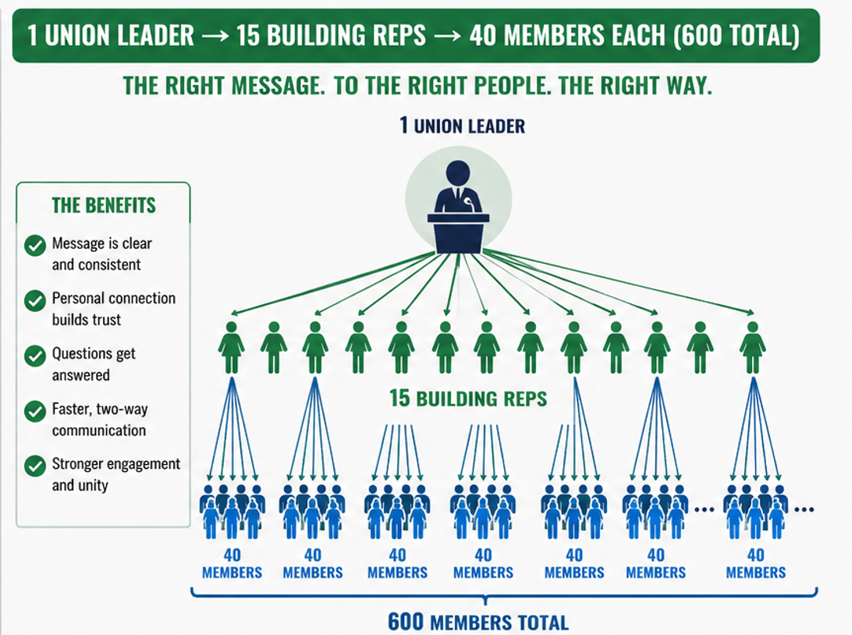


Slide 14
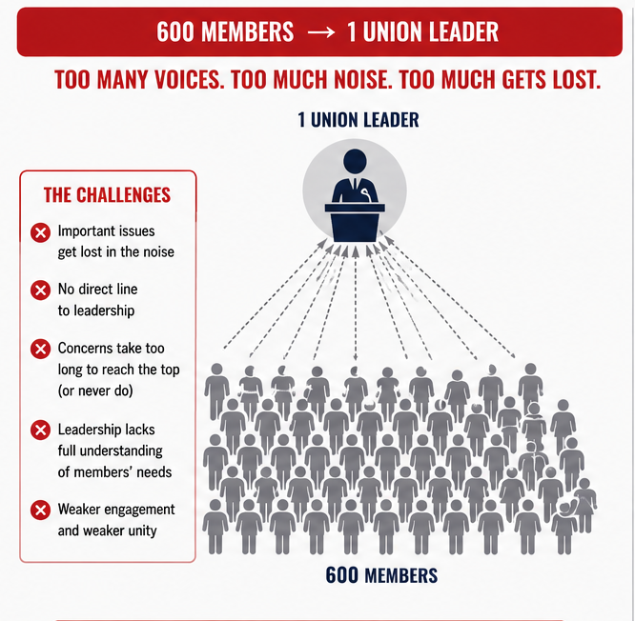

Slide 15
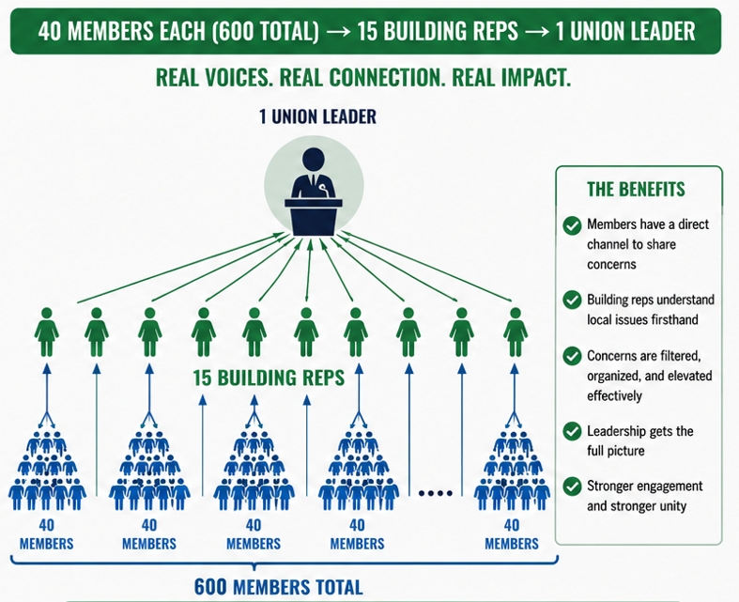


Slide 16
Tools for a Strong Communication Network
Recommended Communication Methods
Email Group
  All building representatives included.
Text Messaging Group
  For urgent updates.
Monthly Building Rep Meetings
  Virtual or in-person.
Shared Contact List
  Keep current phone numbers and emails.
Digital Collaboration Platform
  GroupMe
  Remind
  Microsoft Teams
  Google Groups
Choose tools your reps will actually consistently.

Slide 17
Too much or Too busy?
Delegate to another officer
Find a “Lead Rep” for the local

Slide 18
Monthly Building Rep Check-In Structure
Sample Agenda
County policy concerns
Workplace issues
Membership updates
Upcoming events
Legislative updates
Organizing opportunities
Questions from buildings
Time Required:
30–45 minutes per month
Regular communication prevents surprises.

Slide 19
Expectations for Building Representatives
Ask Every Rep To:
Share information promptly.
Communicate with all members in their building.
Attend rep meetings.
Report concerns.
Welcome new employees and do a membership ask.
Encourage member participation.
Keep Expectations Realistic
Building representatives are volunteers and need to be supported by local leadership.

Slide 20
Supporting Your Building Representatives
Local Officers Should:
Share clear and concise information.
Recognize representatives publicly.
Offer mentorship and support.
Respond quickly when reps raise concerns.
Celebrate successes.
Strong support creates strong representatives.

Slide 21

Measuring Success
Ask Yourself:
Does every building have a representative?
Do members know who their rep is?
Are reps communicating regularly with leadership?
Are issues reaching leadership quickly?
Are members more engaged than they were a year ago?
If the answer is yes, your communication network is working.

Slide 22
Action Plan
Within the Next 30 Days
✓ Identify buildings without representatives.
✓ Recruit new building reps.
✓ Create a master contact list.
✓ Establish a building rep communication group.
✓ Schedule monthly rep meetings.
✓ Clearly define expectations and support systems for reps.

Slide 23

Building Rep conferences

Slide 24
Simple facts
Strong Locals Are Built One Building at a Time
Building representatives transform a union from a small group of officers into a network of leaders throughout every school and worksite.
When every building has a trusted representative, members stay informed, concerns are addressed early, and the union becomes stronger, more responsive, and more effective for everyone.
Building Representatives Are the Backbone of Local & Union Strength.

Slide 25


We are leaders…Go lead!

