Slide 1

SCHOOL SAFETY DEPENDS ON YOU
Region VI
Boone
Lincoln
Logan
McDowell
Mingo
Wyoming

Slide 2
West Virginia Division of Protective Services School Safety Unit
vice school safety unit does not
West Virginia Division of protective services school safety unit does not endorse any specific company or organization and does not endorse or mandate the use of specific literature, safety plans, reports or strategies or their effectiveness for use in west Virginia schools. The Information provided is strictly for informational and educational purposes.
y or organization and does not endorse or mandate the use of specific literature, safety plans, reports or strategies or their effectiveness for use in west Virginia schools. The Information provided is strictly for informational and educational purposes only.

Slide 3
“1, 2, 3 All Eyes On Me”
https://youtu.be/UElCpQKLUHM?si=6SEq1PAq5iMHSoXf

Slide 4


2 Simple Actions to Save Lives

Slide 5

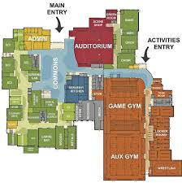
So why is school safety for everyone?
West Virginia Code 18-9F-10 School Safety Requirements provide that at a minimum:
Room numbers to be placed on exterior walls or windows of school buildings
Provide updated floor plans to first responders, local LE, and State Fire Marshals

Slide 6

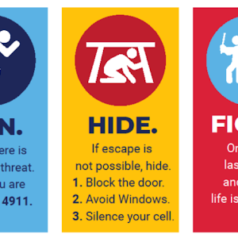
So why is school safety for everyone?
West Virginia Code 18-9F-10 School Safety Requirements provide that at a minimum:
First aid training including blood borne pathogen for all school personnel upon employment
Active shooter training for all school personnel and students at the beginning of each school year.

Slide 7
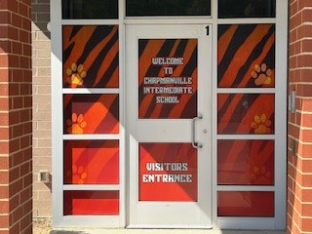
Safe Schools Fund
WV18-5-48
Main priority for the Safe Schools Fund is to ensure that all schools have safe school entrances also known as “man traps.”
Entrance #1 single point entry, two locked doors in containment area.
Electronic locking including camera on the entrance with intercom.
Screened from visibility.

Slide 8
West Virginia School Safety Initiative introduced October 2019.
Developed to assist in the creation and implementation of uniform crisis prevention and response protocols.
Detection and Prevention
Response During a Crisis
Post Crisis Response

Slide 9
West Virginia School Safety Initiative
Key Components
WVDPS School Safety Unit Established
School Threat Assessment Teams
See Something, Send Something App

Slide 10

The Role of Locked Doors and Access Control in School-Based Active Shooter Events
Prepared by: The alerrt center Texas state university

Slide 11

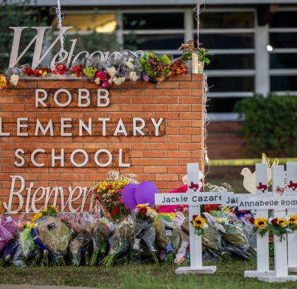
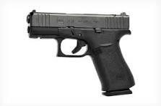
Analysis Centered On
K-12 School Settings
54 Active Shooter Events and 4 Averted Events
Events occurring between 2000-2025
55 Assailants

Slide 12
Key Findings
Secured doors are associated with fewer casualties.
Threat profiles differ by school level.
Glass is the primary point of mechanical failure.
Compliance, not hardware, is the most common failure mode.
Speed of lockdown shapes outcomes.

Slide 13


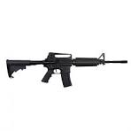

West Virginia Schools By Law Conduct 2 Fire Drills in the First 30 Days and 1 Each Additional Month School is in Session. But Active Shooter Drills are Not Currently Required by Law.
54 Incidents included 135 Killed and 189 Wounded
29 or 53.7% by Handgun
13 or 24.1% by Shotgun
12 or 22.2% by Rifle
18 or 33.3% by Multiple

Slide 14
Shooter Profiles for the 55 Assailants
Shooter Status
Racial Status
51 or 92.7% Male and 4 or 7.3% Female
37 or 67.3% Current Student
10 or 18.2% Former Student
7 or 12.7% No Link to the School
1 or 1.8% Current Staff Member
40 or 72.7% White
5 or 9.1% Bi-Racial, Native American or Asian
4 or 7.3% Black
4 or 7.3% Hispanic
2 or 3.6 % unknown

Slide 15
Perpetrators Interacted with 66 Doors
Entry Status
Door Status
Perpetrators entered 29 or 43.9% of doors.
Perpetrators did not gain entry to 30 or 45.5% of doors.
Door entry status for the remaining 7 doors was unknown.
16 or 55.2% Unlocked.
4 or 13.8% propped/unsecured.
6 or 20.7% mechanically breached by shooting out accompanying glass.
Door status for the remaining 3 was unknown.

Slide 16

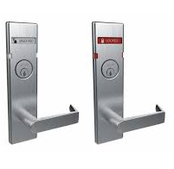
Perpetrators Interacted with 47 of 66 Doors with a Known Lock Status
47 Doors with Known Status
18 or 38.3% Locked
24 or 51.1% Unlocked
5 or 10.6% Propped or Unsecured

Slide 17
Victim Locations
155 or 47.8% in Classrooms
57 or 17.6% in Hallways
46 or 14.2% in Commons Areas
16 or 4.9% Outside the Building
14 or 4.3% in Cafeteria
8 or 2.5% in Office
28 or 8.6% Unknown

Slide 18
Recommendations
1: Ensure that every classroom door has a functional lock that can be engaged from inside the room.
2: Secure all exterior doors during school hours, with controlled visitor access through a single monitored entry point.
3: Assess and upgrade glazing materials on exterior doors and classroom doors with glass features.
4: Establish and enforce a culture of compliance with door security protocols.
5: Invest in rapid lockdown capability, including training, alert systems, and staff empowerment.
6: Tailor security strategies to school level.
7: Eliminate the use of magnetic strips and other aftermarket door props.
8: Establish standardized protocols for documenting door and access-control hardware during post-incident investigations.

Slide 19

ANONYMOUS REPORTING
All tips are received at WVDPS Capitol Police Communications.
All tips received an incident number, are investigated and archived.
Threats can be imminent or non-imminent in nature.
Imminent threats go to FBI, WVSP, WVDPS, county 911 where threat is located, SRO, Superintendent.
Tips are anonymous but can be “unlocked” for additional information.

Slide 20

SEE Something, SEND Something
Non-Imminent threats such as bullying, vaping, safety issues go to WVDPS, Safety Directors, Superintendents.
The App can be downloaded for FREE on ALL school devices.
The App can be downloaded for FREE on all cell phones from any app store.
SEE Something, SEND Something App is FREE for ALL county school systems.

Slide 21
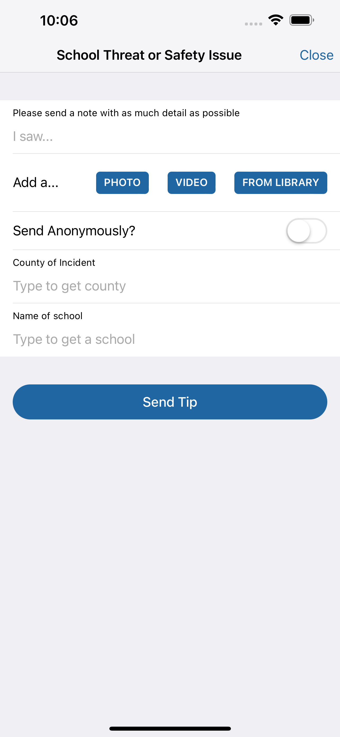
Select “School Threat or Safety Issue”
Type tip in “I Saw…” section
Add photo or video
Send anonymous or with user information
Select County and School

Slide 22
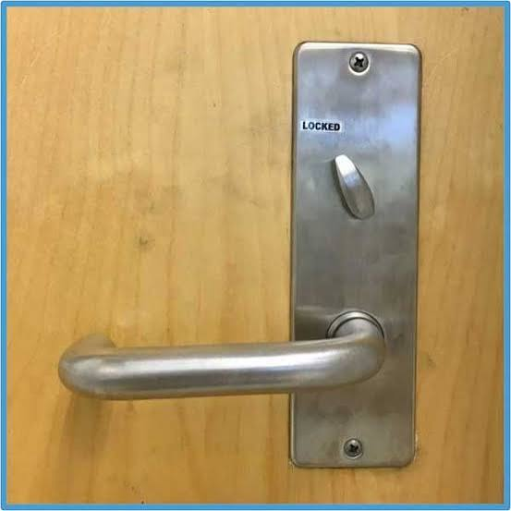

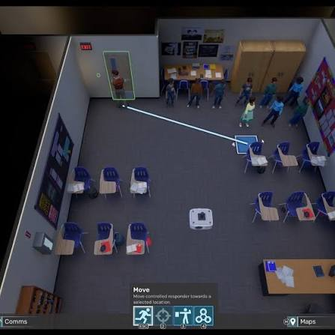

Locks, Lights and Out of Sight
Doors locked during instructional hours
Window coverings
Lights Off!!!
Find “Hard Corners”
Teaching station away from door creates reaction time

Slide 23
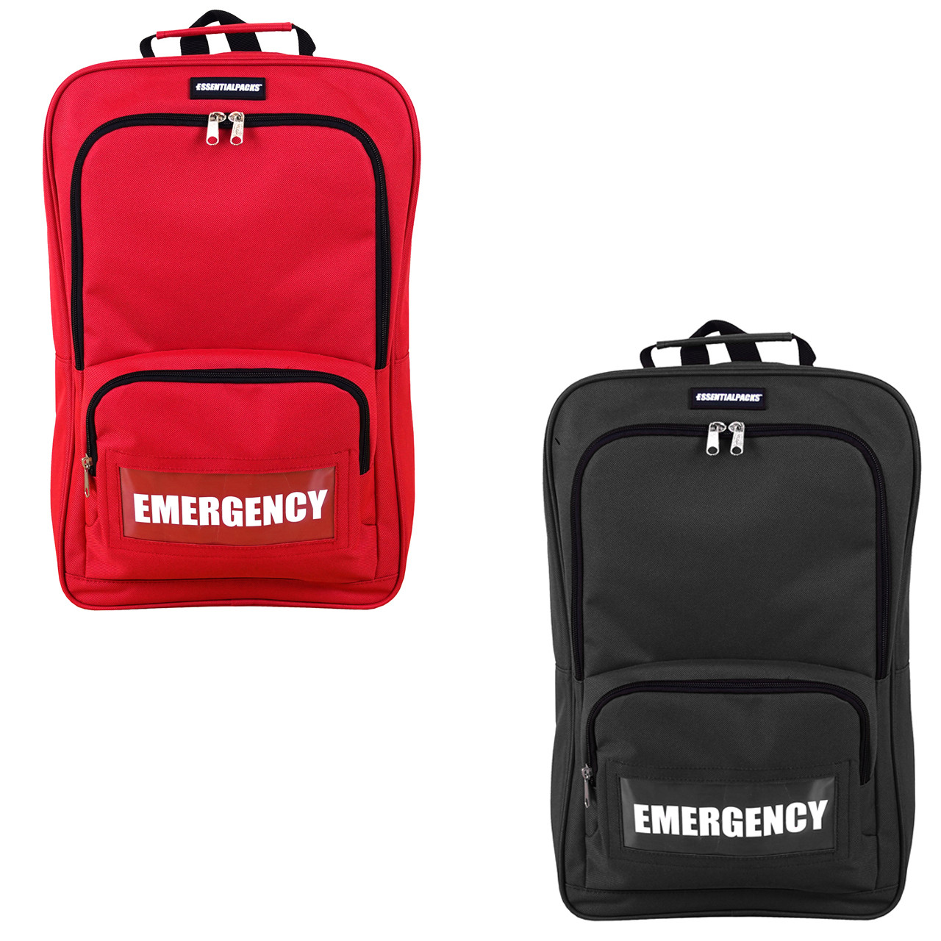

EVACUATION TIPS
Go Bags: teacher meds, first aid kit, phone with charger
ID badges, student rosters with photographs

Slide 24
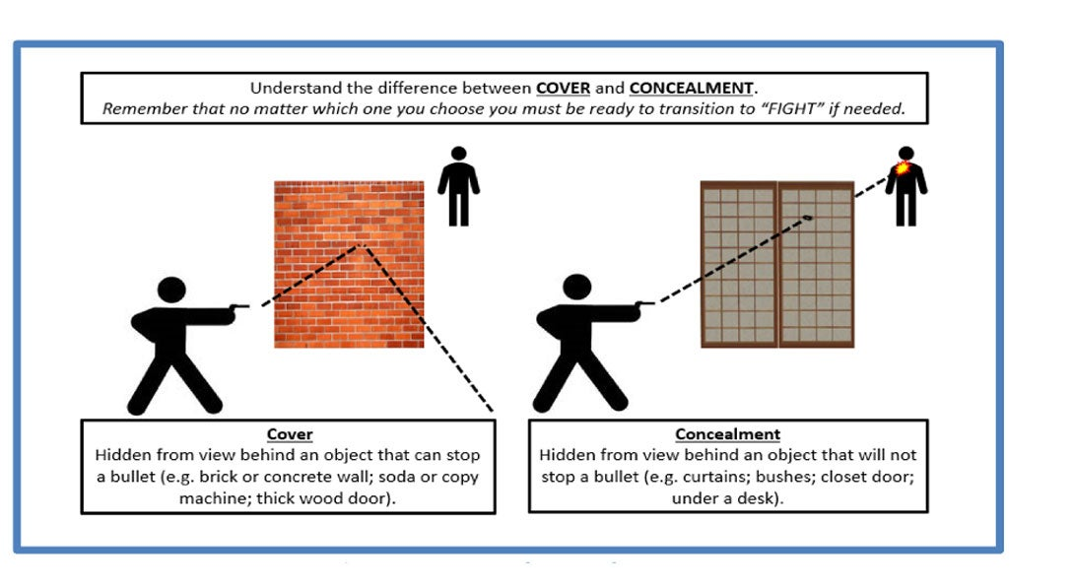
COVER AND CONCEALMENT

Slide 25
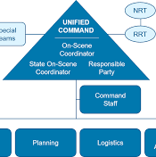



PROVIDE SCHOOL PERSONNEL WITH THE TRAINING FOR THEM TO SUCEED DURING ACTIVE THREAT DRILLS AND INCIDENTS
Run Hide Fight
Incident Command System
“I Love U Guys” Reunification
Stop the Bleed
First Aid

Slide 26

COMMUNITY PARTNERS
WEST VIRIGINIA SAFE SCHOOLS HOTLINE
1-866-723-3982 OR 1-866-SAFE-EVA
WEST VIRGINIA WATCH CENTER
1-866-989-2824 OR 1-866-WATCH
SEE SOMETHING, SEND SOMETHING
24/7/365

Slide 27



BUILD RELATIONSHIPS WITH COMMUNITY PARTNERS
Identify the leadership of partner organizations
Learn the areas of expertise and what the partner can provide
Add partner roles and contact information into crisis planning
Invite partners to speak at your school and be part of safety planning

Slide 28

TEN ESSENTIAL ACTION TO IMPROVE SCHOOL SAFETY

Slide 29
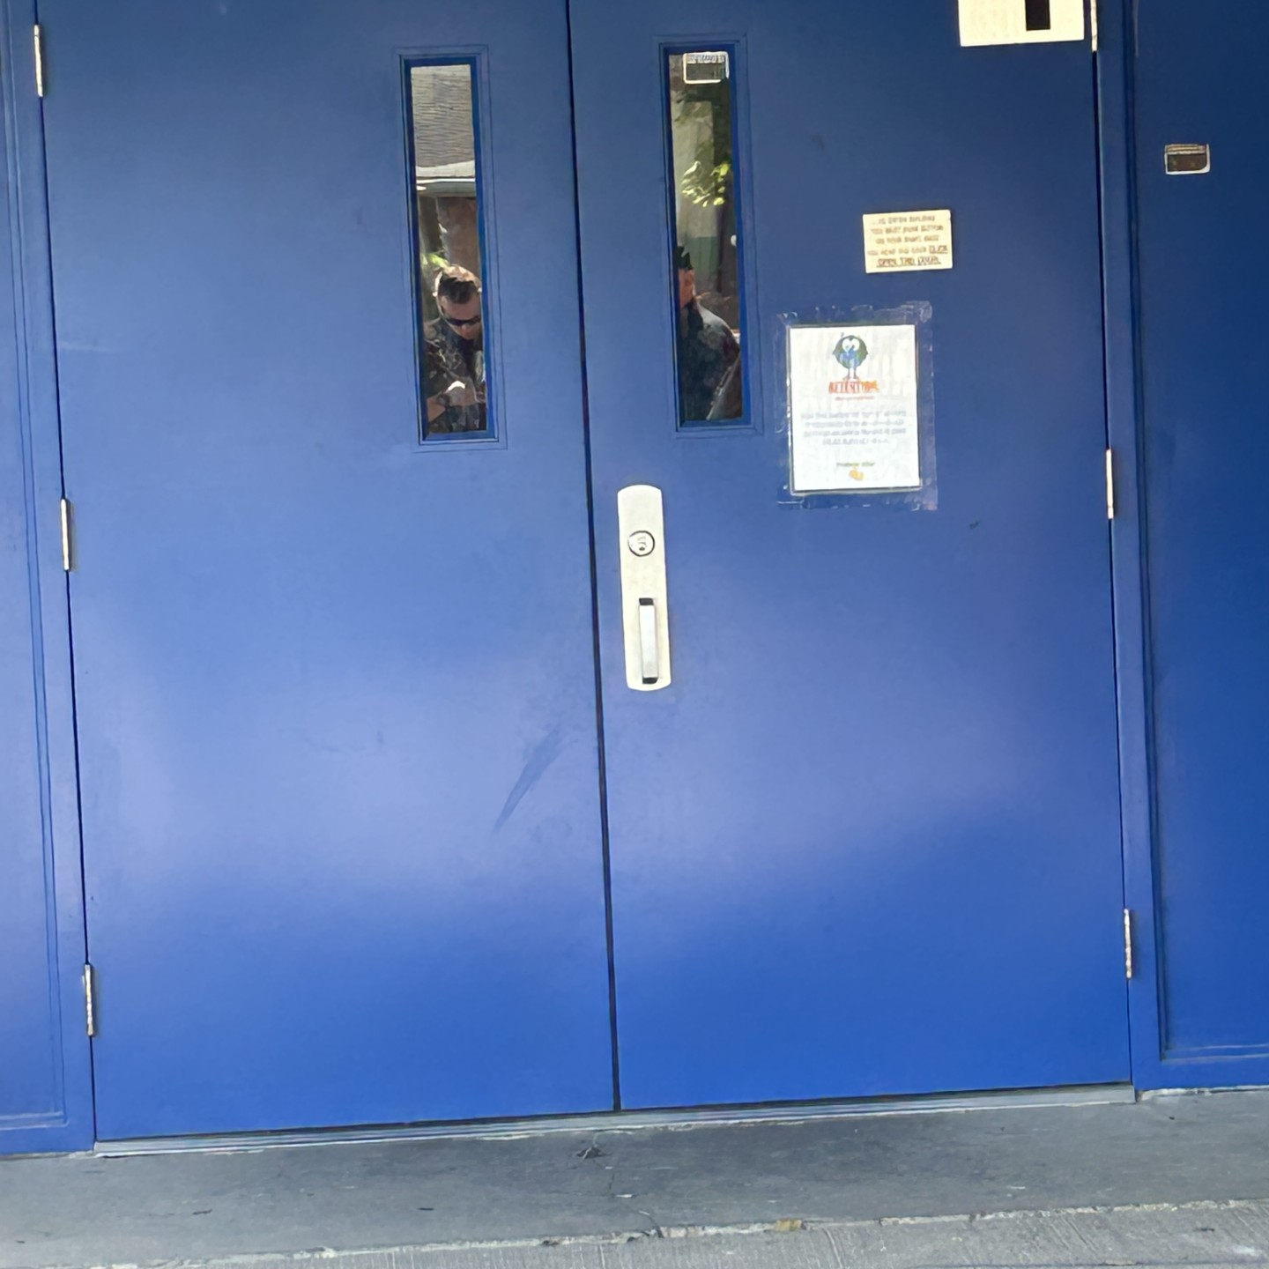
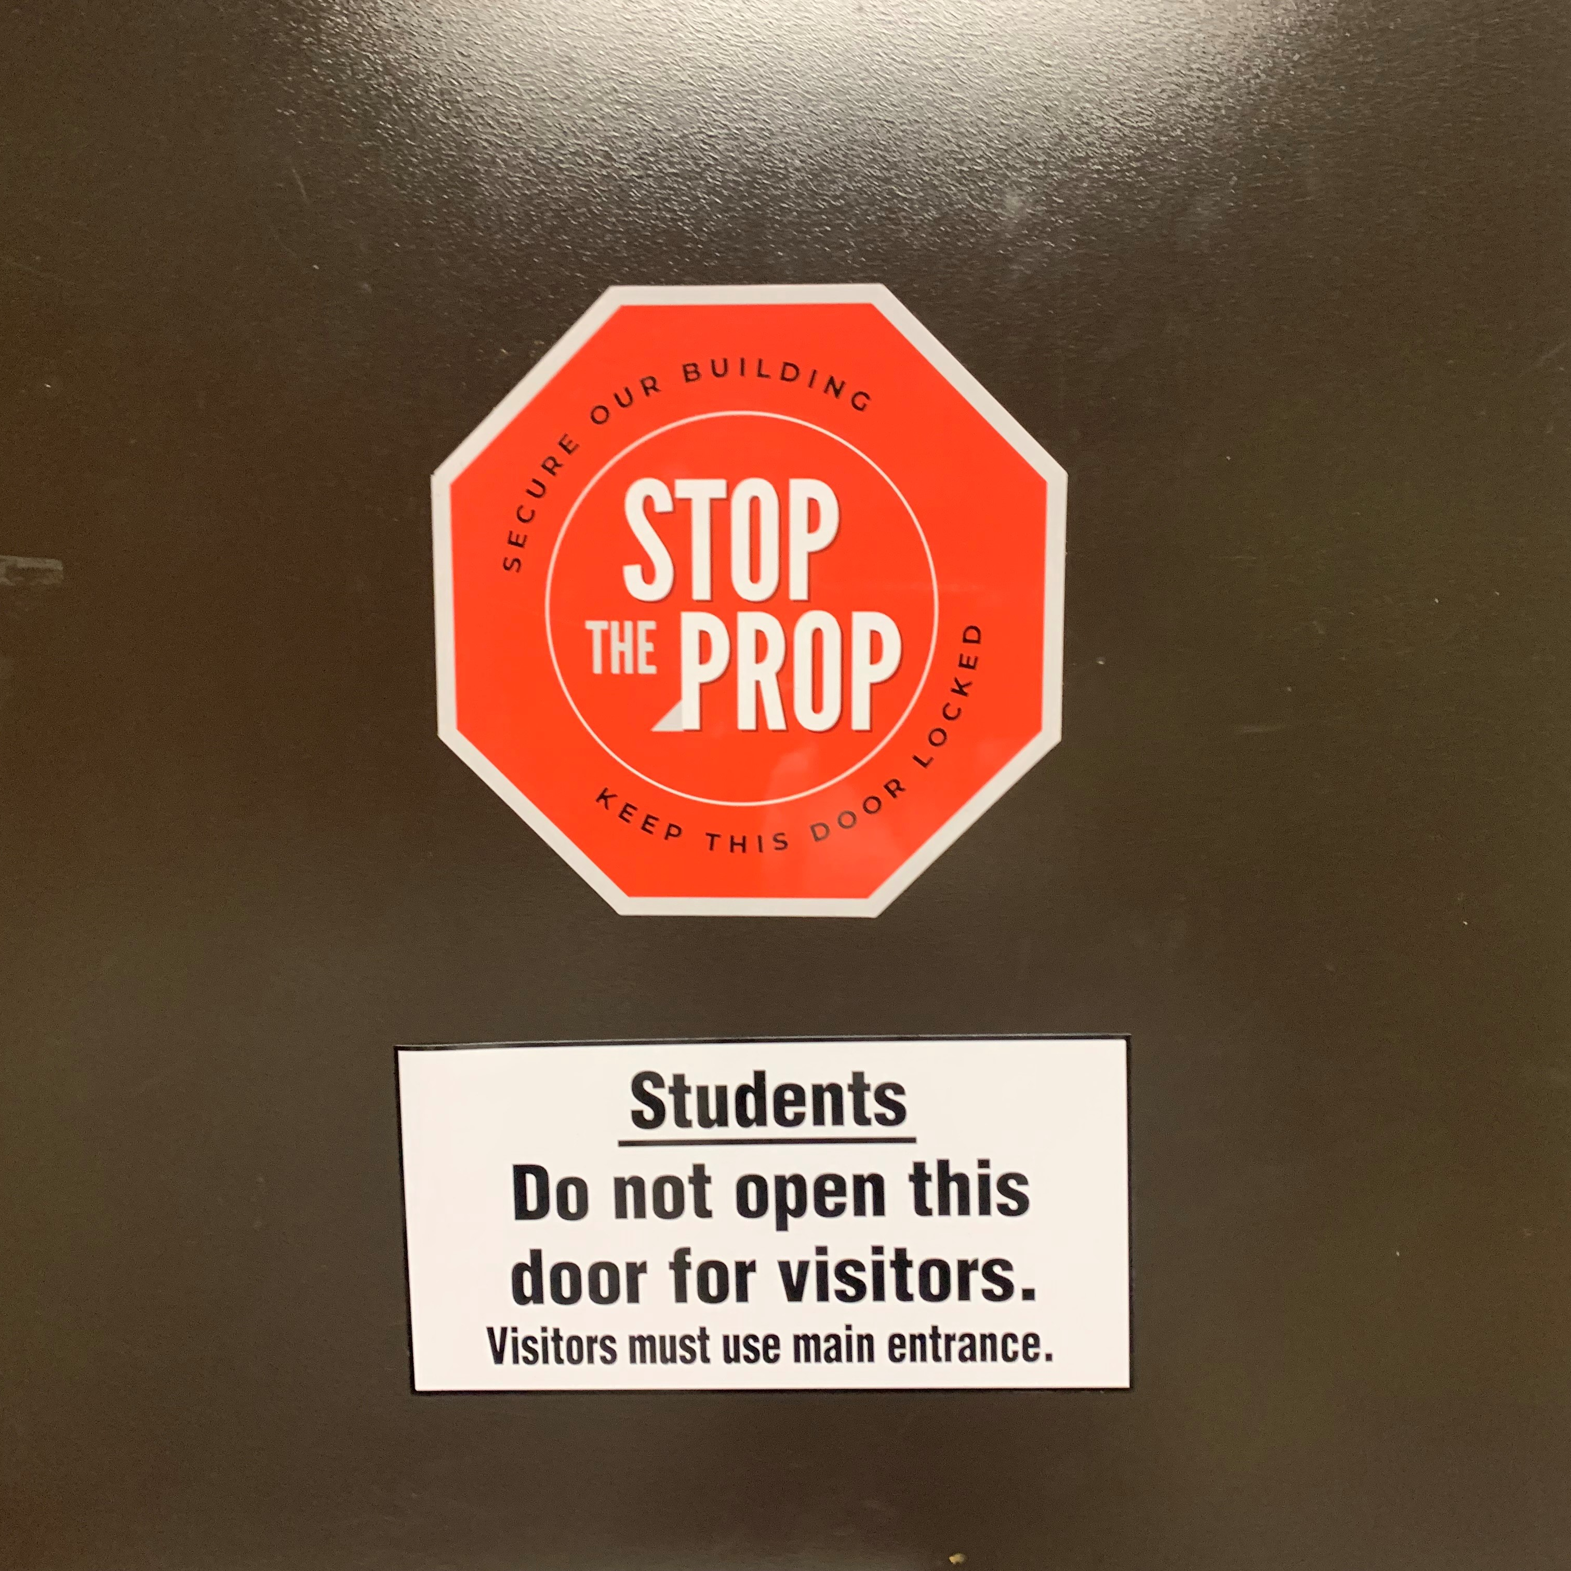


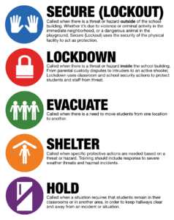
Ten Essential Actions for Physical and Emotional Safety of Schools:
Physical Safety
Comprehensive School
Safety Assessment
Campus, Building, and Classroom Security
Coordination with First Responders
School Based Law Enforcement
Drills

Slide 30




Ten Essential Actions for Physical and Emotional Safety of Schools:
Emotional Security
School Climate
Anonymous Reporting Systems
Behavior Threat Assessment and Management
Mental Health Resources
Social Media Monitoring

Slide 31
Comprehensive School
Safety Assessment
ASSESS THE RISKS
IDENTIFY THE THREATS
The foundation for all school safety and security planning and operations is a comprehensive risk assessment that identifies the highest probability threats, their potential consequences, and the school’s vulnerabilities to those threats.
Possible Threats: school shooter, hazardous materials spill, flooding

Slide 32

School Climate
Fostering a culture of connectedness. This aspect arose from the isolation and detachment often manifested by school shooters.
Conversely, a positive school climate promotes respectful, trusting, and caring relationship and open lines of communication. Students feel comfortable asking for help or reporting concerns about their peers.
Such as bullying prevention/awareness programs

Slide 33
Campus, Building and
Classroom Security
“One of the biggest concerns raised by schools and school districts since the Parkland shooting has been their inability to easily sift through the multitude of security options, equipment, technologies, etc.,….”
“…It is essential for schools and school districts to begin their planning for security upgrades with a comprehensive risk assessment that identifies gaps in campus, building, and classroom security.”
Weapons detection, video cameras, mapping tech

Slide 34

ANONYMOUS REPORTING SYSTEMS
“Successful anonymous reporting systems educate all members of the school community on indicators of potential self-harm or violence and how to share this information so officials can intervene before violence occurs. Anonymous reporting systems use a variety of vehicles… including mobile applications, online, email and phone. Among the most important aspects of anonymous reporting systems are robust tracking and accountability measures to ensure adequate follow-up on all reported threats.”

Slide 35
COORDINATION WITH FIRST RESPONDERS
“Coordination between schools and law enforcement begin with the safety assessment and flow through development of policies and the emergency operations plan to training, ongoing drills, and periodic evaluation. It is imperative that roles and responsibilities be clearly defined, clearly communicated, and practiced…”

Slide 36
BEHAVIOR THREAT ASSESSMENT AND MANAGEMENT TEAM
IDENTIFY THE THREAT
01
ASSESS THE THREAT
02
MANAGE THE THREAT
03

Slide 37
SCHOOL BASED LAW ENFORCEMENT
“The ability of specially selected and trained SROs to establish trust relationships with students has been demonstrated to prevent school shootings. In addition, there have been numerous documented instances of SROs directly intervening to prevent or quickly mitigate active school shootings.”
SCHOOL RESOURCE OFFICERS
SCHOOL PREVENTION OFFICERS
SCHOOL SECURITY OFFICERS
REGIONAL SCHOOL SAFETY OFFICERS

Slide 38

MENTAL HEALTH RESOURCES
Schools play a key role in preventing youth mental, emotional, and behavioral difficulties, identifying and supporting students with mental health problems and reducing youth violence.
Including prevention, early intervention, and treatment.
School employed mental health professionals: daily accessibility, continuity and sustainability of services. Including partnerships with community based and local social services providers.

Slide 39
DRILLS
Recommended the use of options-based approaches that are age appropriate. Creating muscle memory and clear expectations of everyone’s role during an emergency are best achieved through the conduct of armed assailant drills on a regular basis throughout the school year.

Slide 40

SOCIAL MEDIA MONITORING
Defensive social media monitoring, also referred to as social media alerting systems, provide constant online scanning of messages with a geofence around a school or school district to identify threats and at-risk behavior including cyberbullying.
IT programs for school technology monitoring

Slide 41
West Virginia School Safety Laws
18-9F-10a
18-9F-9a
Standardized school safety mapping data
The school safety mapping requirements shall be effective on September 1, 2026.
Also known as “Alyssa’s Law” requiring that a wearable panic alert system device shall be implemented at every school in the state.
Legislative rule in compliance effective December 31, 2026.

Slide 42



West Virginia Division of Protective Services (Capitol Police) School Safety Officers
Prevention Resource Officers Logan County Sheriffs Department
School Resource Officers McDowell County Sheriffs Department
School Safety Officers Kanawha County Schools

Slide 43
WVDPS School Safety Officers
The School Safety Unit within the Division of Protective Services shall primarily be charged to provide services to all public primary and secondary schools and may provide services to any private primary and secondary schools in the state upon request. The School Safety Unit will be tasked to make school safety inspections and to make recommendations to appropriate county school superintendents, principals, or other school administrators, regarding school safety. The officers assigned to the School Safety Unit shall also be authorized to respond to and investigate all school safety matters, in consultation with county boards of education. Any officer of the School Safety Unit has statewide jurisdiction and powers of general law enforcement and arrest for violations of law committed in their presence.
WV15-2D-3

Slide 44
Logan County Sheriffs Department Prevention Resource Officer Program
The Logan County Sheriff's Department's Prevention Resource Officer (PRO) Program operates under the statewide West Virginia Division of Administrative Services mission. Its core goals are to prevent juvenile crime, mentor youth, improve student knowledge of the criminal justice system, and provide a safe learning environment by combining child advocacy with law enforcement.
WV18-5-5 WV18-5-13
WV18-5-48 WV18-5-52

Slide 45
McDowell County School Resource Officers
“The School Resource Officer Program began in McDowell County in 1999. It is a cooperative program between the McDowell County Sheriff's Department and the McDowell County Board of Education that puts a fully uniformed officer in the schools, but not entirely for law enforcement purposes. The program is designed for the students to get to know the officers and for the officer to get to know the students on a different level. For 2025-2026 school year, there are three SROs in the McDowell County school system. These officers spend their entire day at school and attend most all-school and after-school functions. The officers provide a sense of security to students and teachers. These officers are considered invaluable to the schools, and once implemented, the schools feel that they would not want to function without one.”
WV18-5-52

Slide 46
Kanawha County Schools School Safety Officers
“Thanks to funding from the excess levy, Kanawha County Schools was able to hire 12 dedicated school safety officers. Unlike School Resource Officers (SROs) and Prevention Resource Officers (PROs), who are assigned through partnerships with local law enforcement agencies, these safety officers are KCS employees whose sole responsibility is to protect our schools. All 12 officers are retired law enforcement professionals bringing decades of experience and a deep understanding of the local community to their roles. They communicate closely with one another throughout the day and regularly visit schools to provide a visible safety presence, respond quickly to concerns, and build relationships with staff and students…”
WV18-5-52

Slide 47

START CONDUCTING DRILLS
“One more report on school violence and one more conference on school safety won’t make a single American school safer.”
U.S. Representative Bill Goodling, Pennsylvania

Slide 48
2 Simple Actions to Save Lives

Slide 49
REPORTS AND RESOURCES

Slide 50
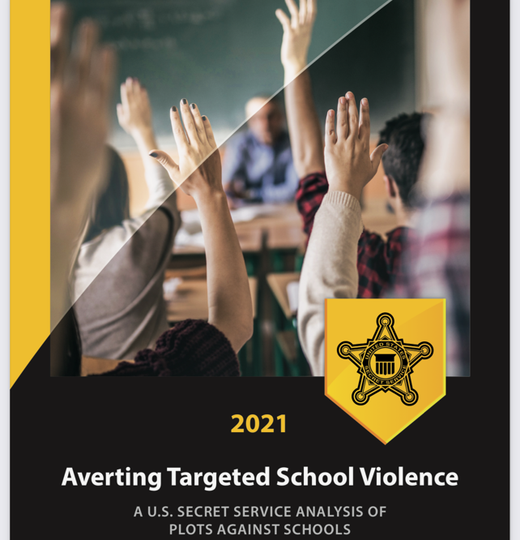
REPORTS AND RESOURCES

Slide 51
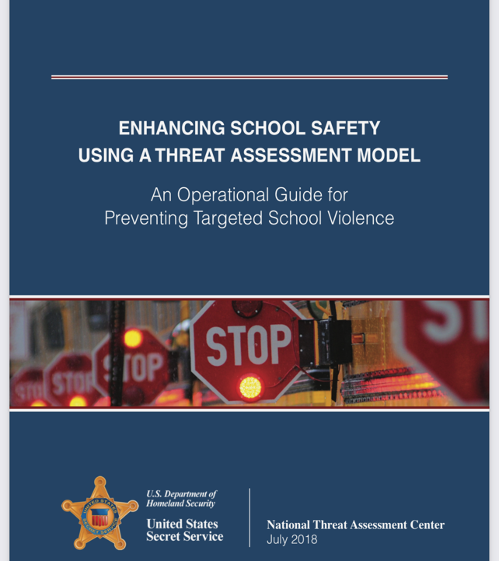
REPORTS AND RESOURCES

Slide 52
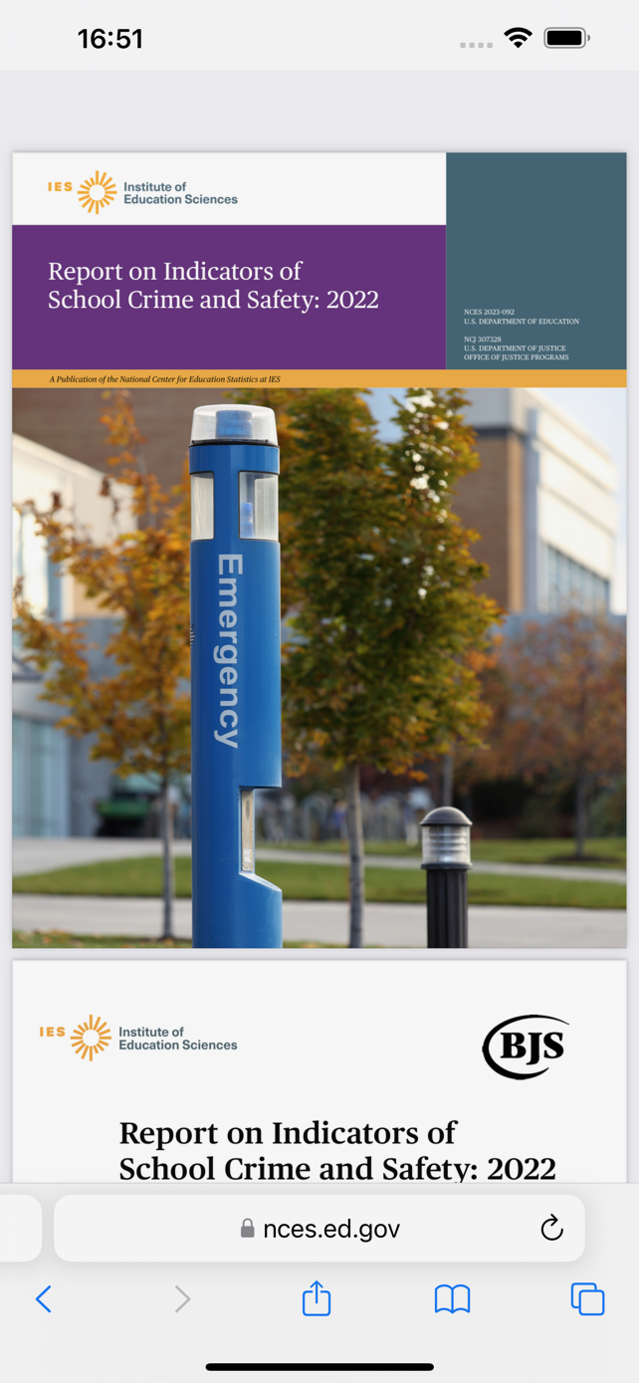
REPORTS AND RESOURCES

Slide 53

REPORTS AND RESOURCES

Slide 54
REPORTS AND RESOURCES

Slide 55
WVDPS AND PRO REGIONS MAPS

Slide 56
SAFETY DEPENDS ON YOU
DISCUSSION & QUESTIONS

Slide 57


CONTACT INFORMATION
Officer Brian M. Brown
West Virginia Division of Protective Services
Capitol Police School Safety Unit
West Virginia State Capitol Complex
1900 Kanawha Boulevard, East
Building 1, Room 152A
Charleston, WV 25305
304.558.9911 Office
304.389.9092 Cell
brian.brown@cappd.wvsp.gov
Retired

