Slide 1

Organizing Issue:
Lifewise

Slide 2
Educate
What is the issue?
How do our members feel about it ?
Research its implications on our schools , on West Virginia schools, or public schools in general if applicable
What actions do our members wish to see we, as a union, take?
Organize
Identify action/s
Make a Plan
Identify Allies
Identify Opposition realistically represent what that might look like , threats etc ..
Empower
Carry out plan
Who do we address: central office, BOE, Legislature, ect?
What is the ask?
Positive Attention to matter,
Public Perception
Media Coverage
Change
What follow up do we do IF we enact the change we want ?
What does it look like if we didn’t “win” ?
Organizing Steps

Slide 3
Educate: yourself, your members, and others
Educate
Research the program and its implementation and effects in public schools across US , focusing on Ohio
https://lifewise.org/
https://respectpublicschools.com/
-Talk to members: use building reps to directly communicate with members (particularly helpful structure if time is limited)
-Strong/ engaged building representatives are key
-Outreach from leadership to individual members and reps.
-Polling virtual or in person , meeting, one-on-one conversations
-Talk to others with lived experience with issue , Ohio teachers / parents / students
Page #

Slide 4
Organize
Identifying Allies:
BOE members
ACLU / FFRF
Community Stakeholders
Religious Leaders
Parents
Political Organizations: Where do we go from here?
Other existing structure in our community/state for advocacy
Outside Allies: Secular Education Association
Page #

Slide 5
Organize
Plan with members and stakeholders:
Who are we addressing?
What is the “ask” ?
How will we address it ?
Who are our spokespeople?
What roles do our leaders, EC, building reps, members have?
What roles do our allies have?
Page #

Slide 6
Do the thing
Empower
Carry out plan as local
Ask members to also take individual action:
emails, BOE contact , legislative contact, public support of position, ect
Ask members to “show up”
Ask allies to take action / show up
Page #

Slide 7
Change
What happened?
How do we respond to a “win”?
celebrate the wins and use for further organizing & membership
How do we respond if we don’t “win” ?
Member engagement and follow up
Public / Media

Slide 8
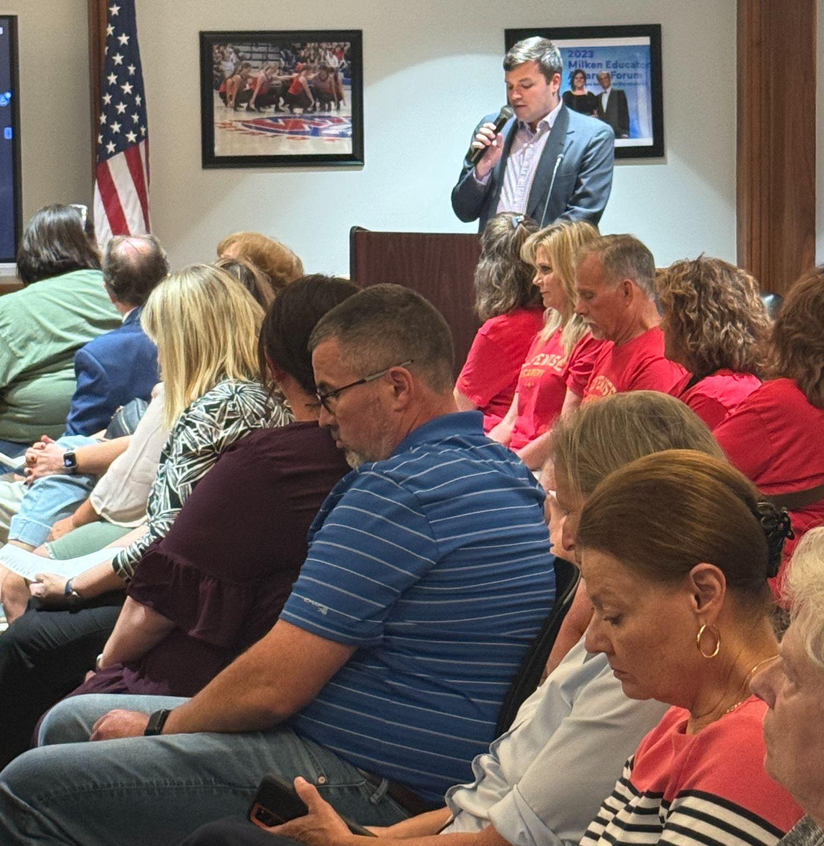
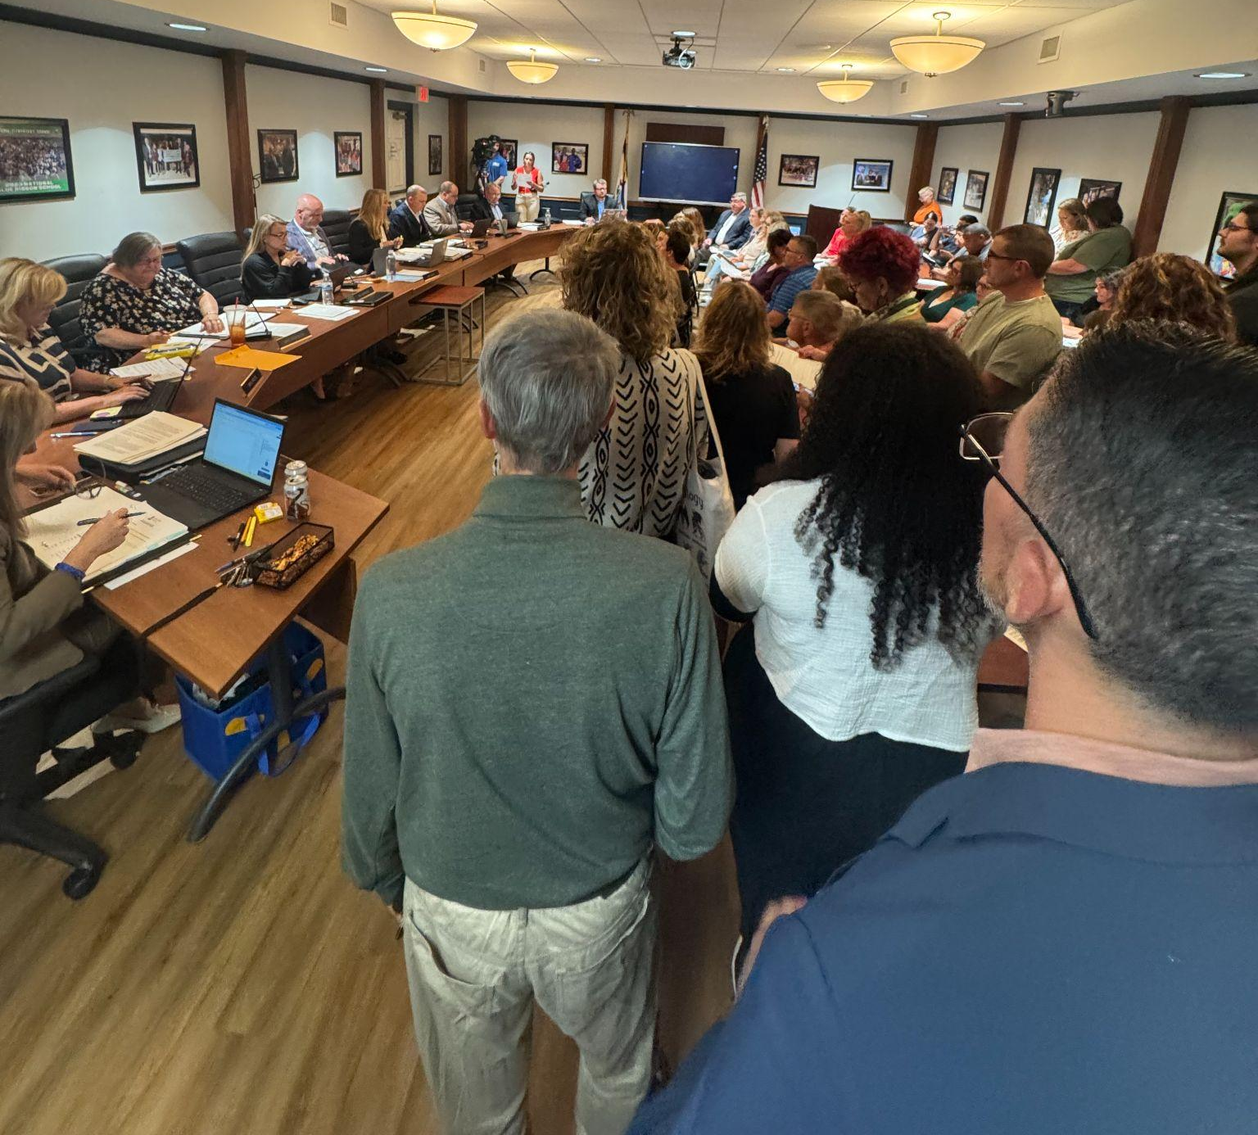
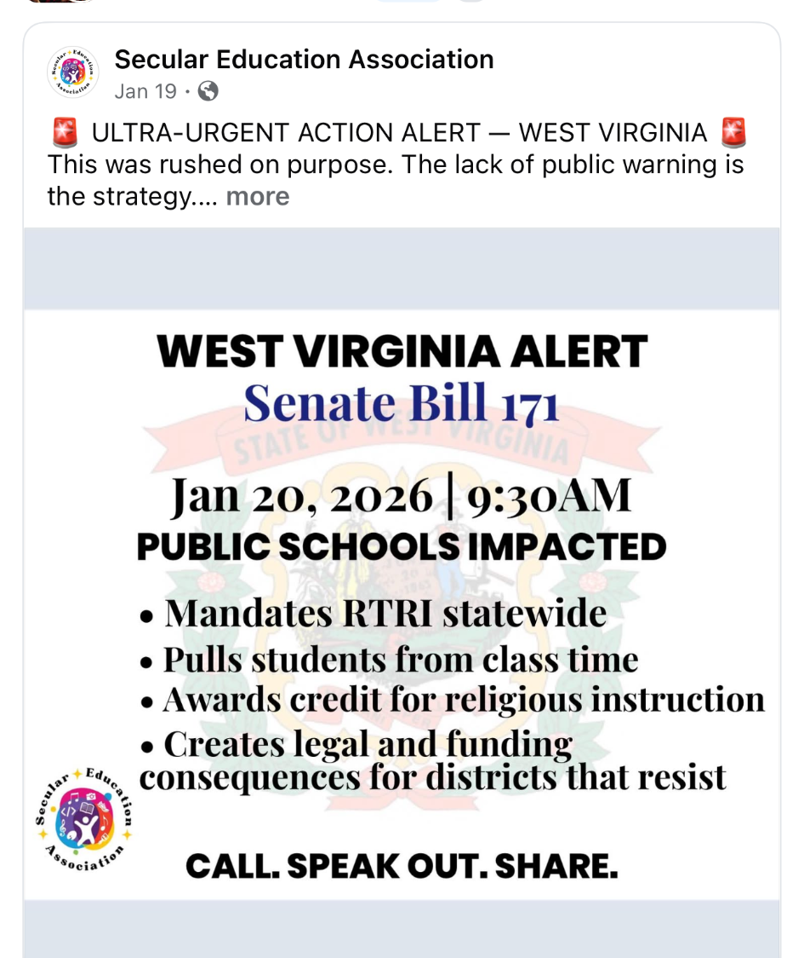
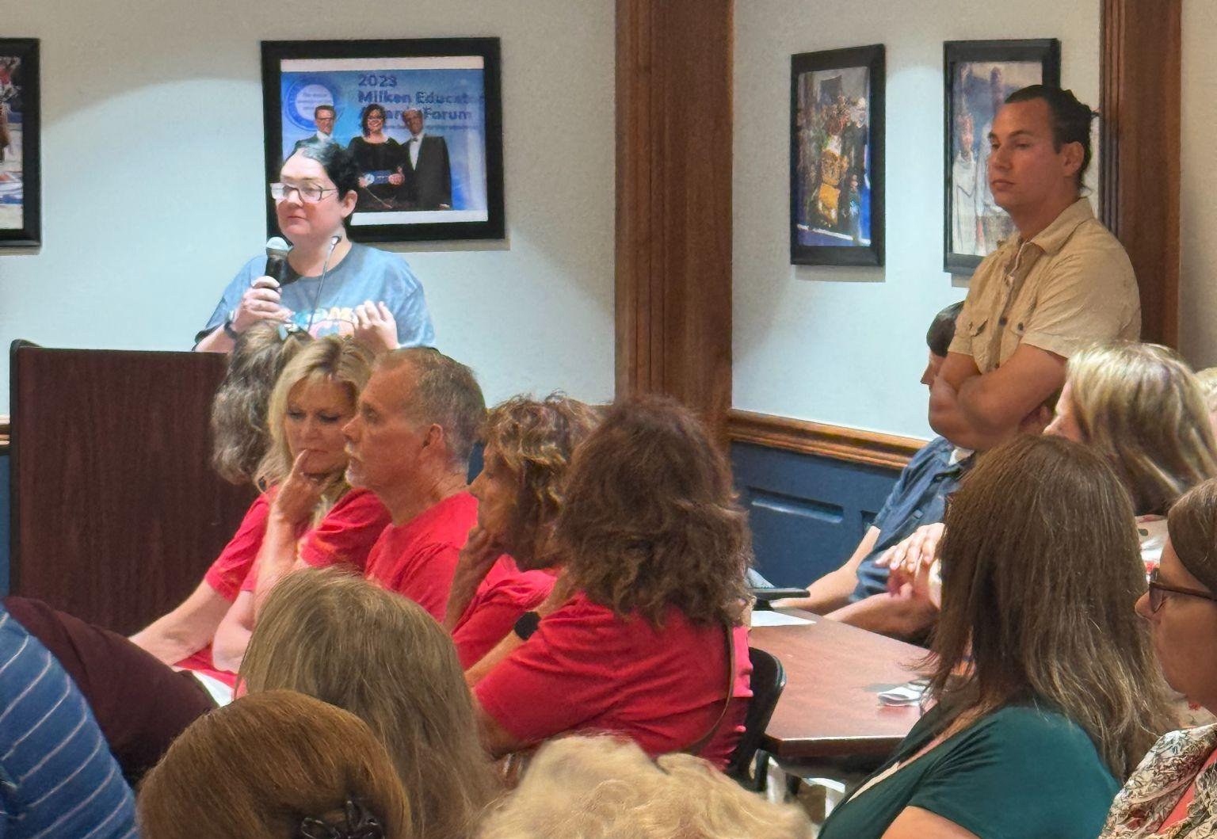
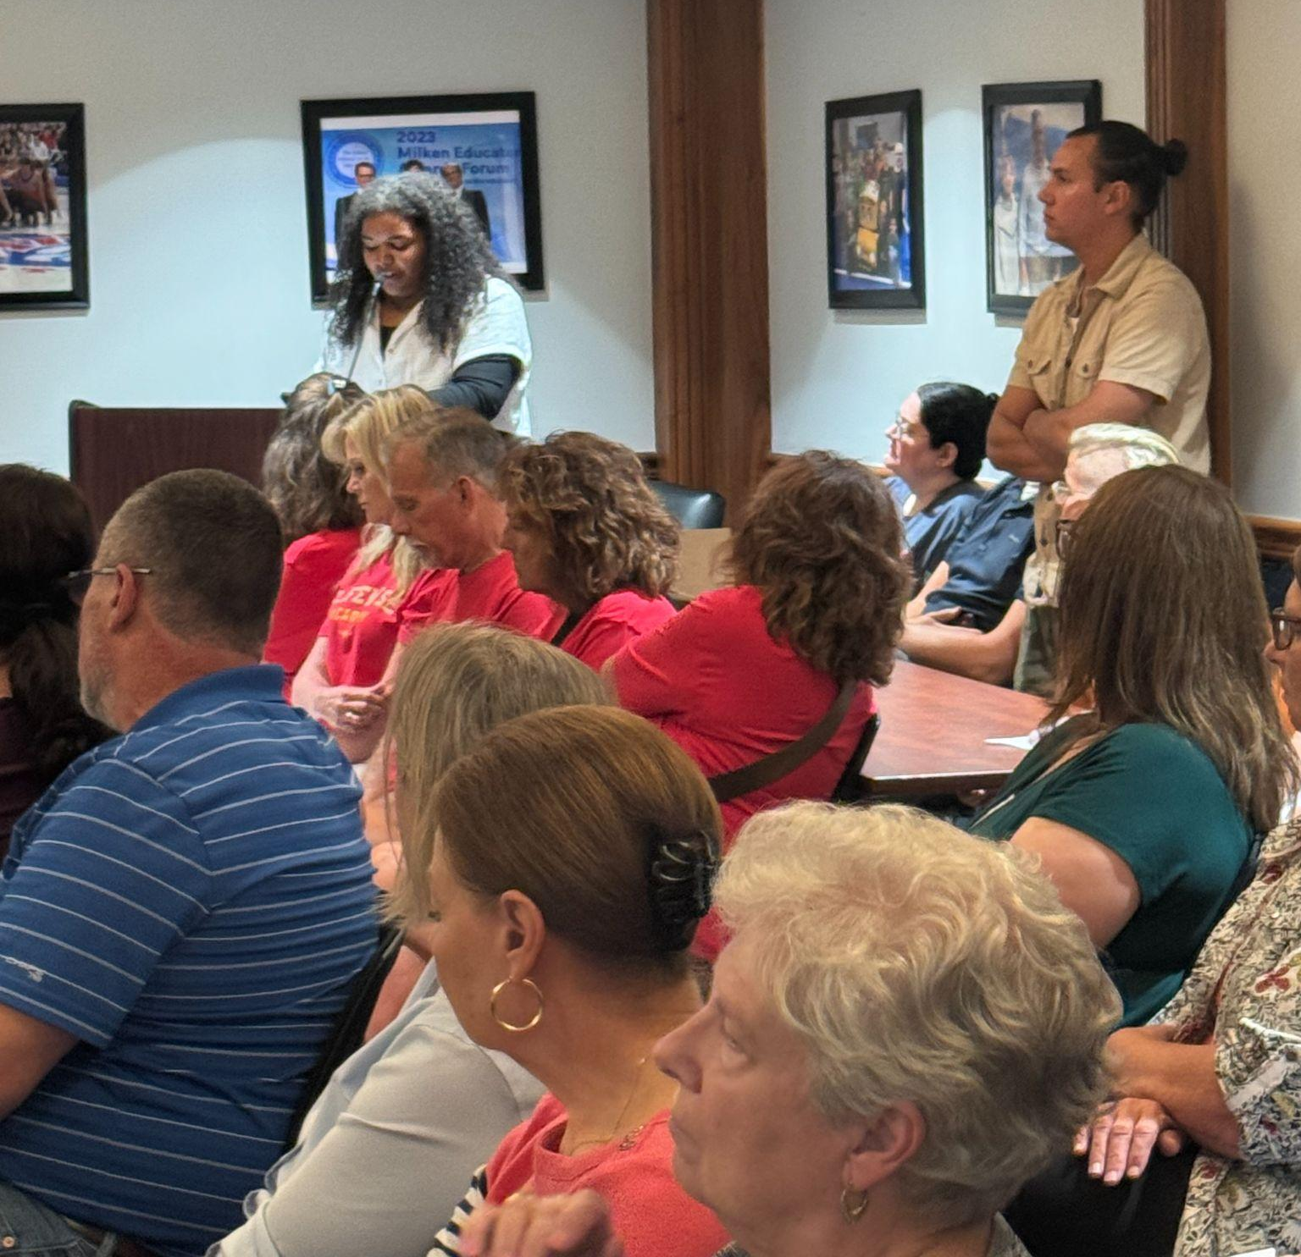
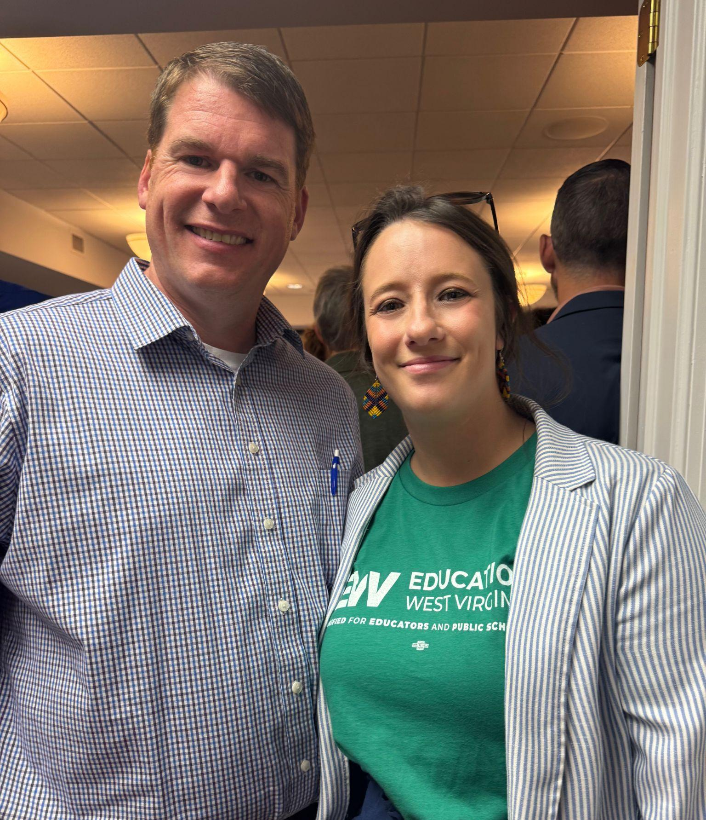
SB 171
Success
in stopping
SB 171 (RIRT)
Ohio County School Board Denies Request To Transport Students for Religious Classes During Lunchtime | News, Sports, Jobs - The Intelligencer
EWV-Ohio Statement on Life Wise

Slide 9
Organizing for action
doesn't always mean
an immediate or one
time “win” or “loss”
Pay Raise
EWV-Ohio has asked for pay raises\ HSA the past several years to offset low state wages and PEIA raises
Educate: meet with other county leaders to find out what incentive/s their county officers
Ask members their feelings, what they’d “ask” for
Organize: meet with BOE / Admin to have place on agenda, get members and allies to show up at BOE meeting, reach out to media/ write, oped get public on your side
Empower: get members involved in the ask , have members and reps present and or show up at BOE meeting
Change: continue to push for what members need even after being told no, keep showing up- no long term raise but secured a “winter stipend”
https://www.theintelligencer.net/news/community/2026/05/ohio-county-teachers-union-asks-winter-stipend-become-permanent-pay/
Start Times
EWV Ohio has utilized our Faculty Senate process to push back against school start time delays since 2019
We successfully educated our members the FS process and rights they have to address FS and the rights FS have to address Administration And the BOE
We have successful represented our members’ concerns as well as concerns of administrations, parents, students, and community members
https://www.theintelligencer.net/news/top-headlines/2026/06/public-says-no-to-ohio-county-boe-on-later-start-times/
School Funding: Levies, Bond, and Ballot Amendments
With our community partners: OCS PTA, OCS Administration and BOE, Wheeling Ohio County Library, WV Center on Budget and Policy, and other unions - EWV Ohio has hosted community town halls and voter outreach initiatives to educate to public on the importance of passing our school levies and bond and to reject Amendments 2 and 4
https://wtov9.com/news/local/west-virginia-amendments-2-and-4-discussed-at-ohio-county-town-hall
“Book Bans”
With community allies, we successfully got 10 removed books placed back in classrooms
https://wtov9.com/news/local/community-members-question-ohio-county-schools-stance-on-some-books

Slide 10
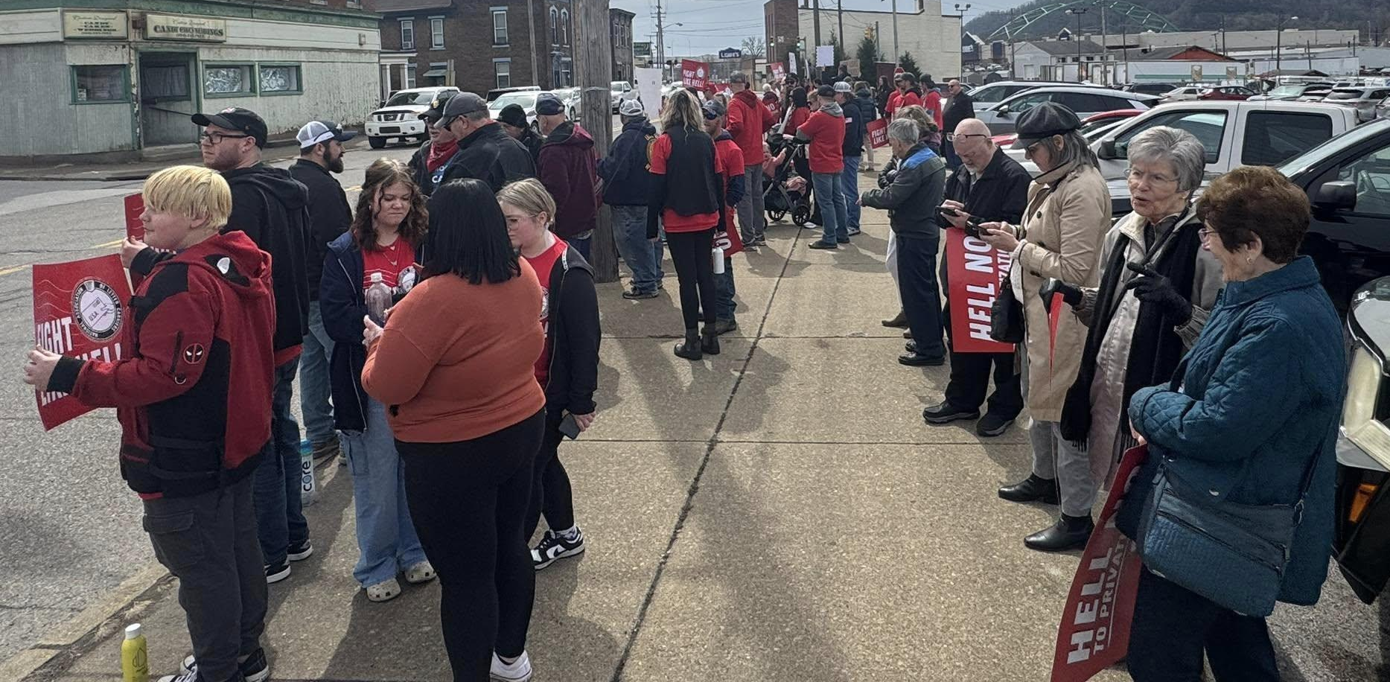
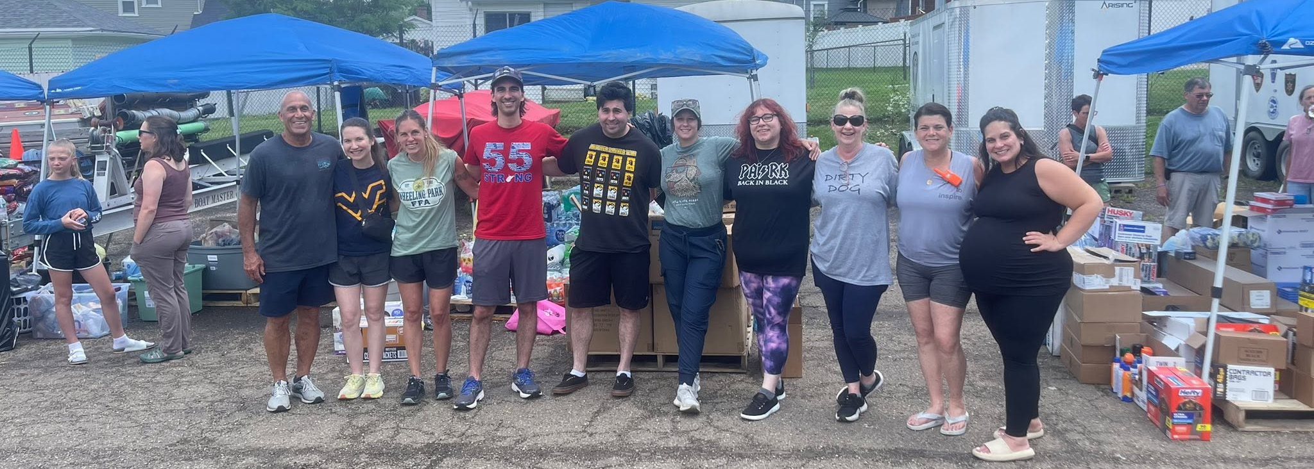
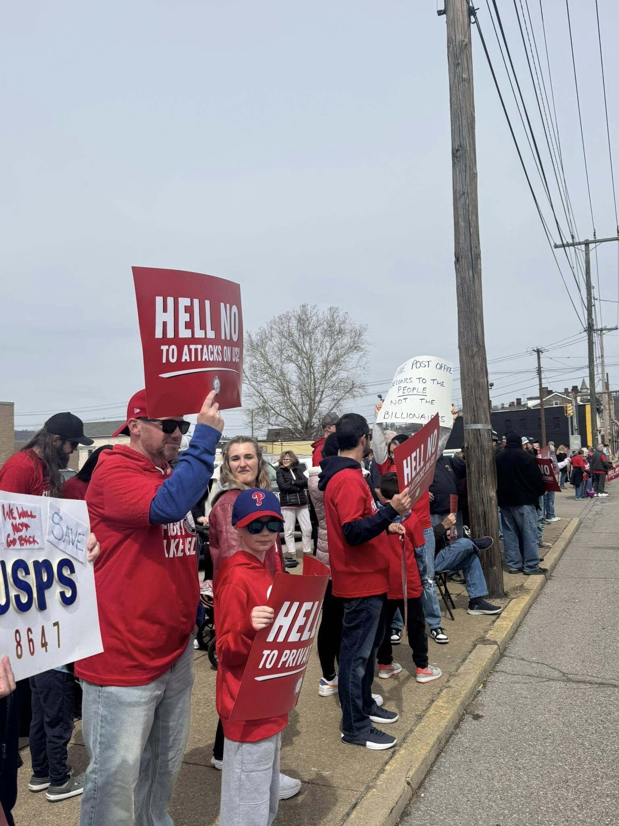
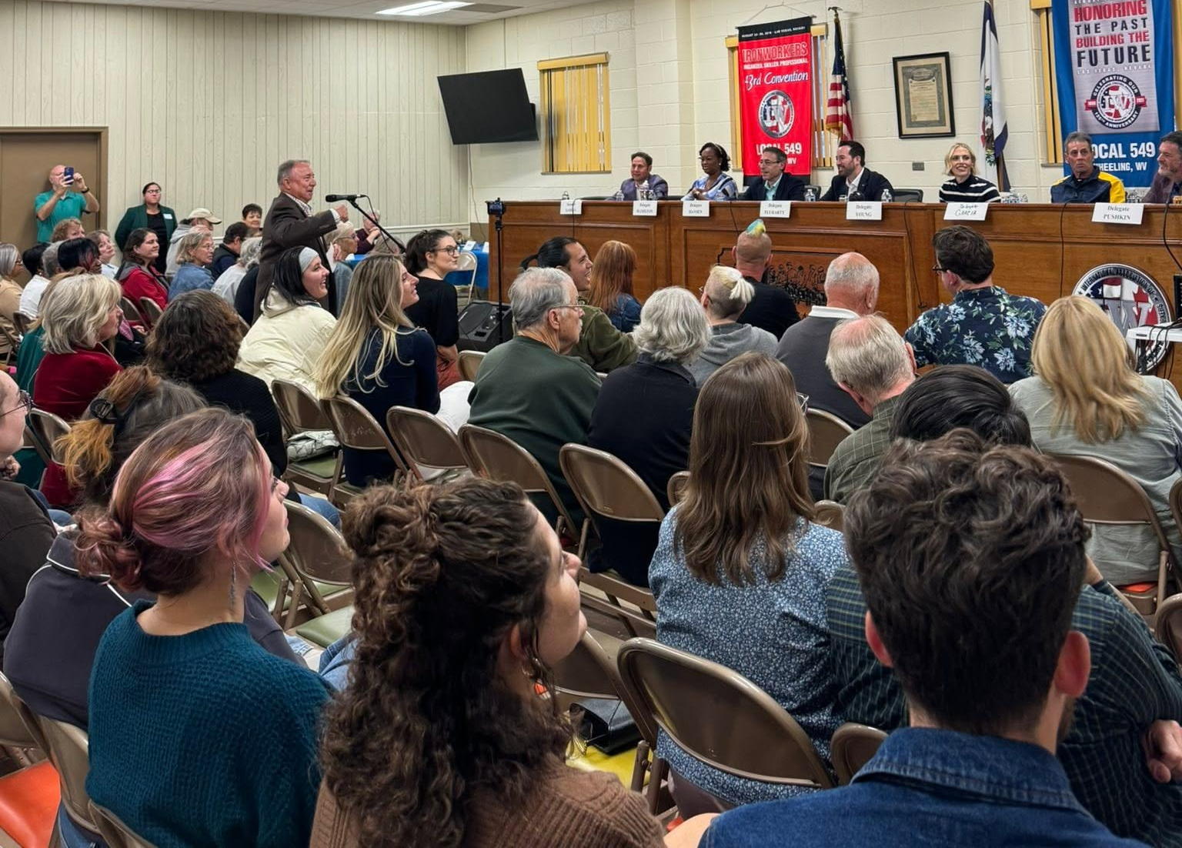
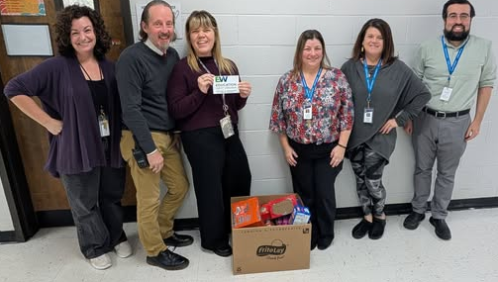
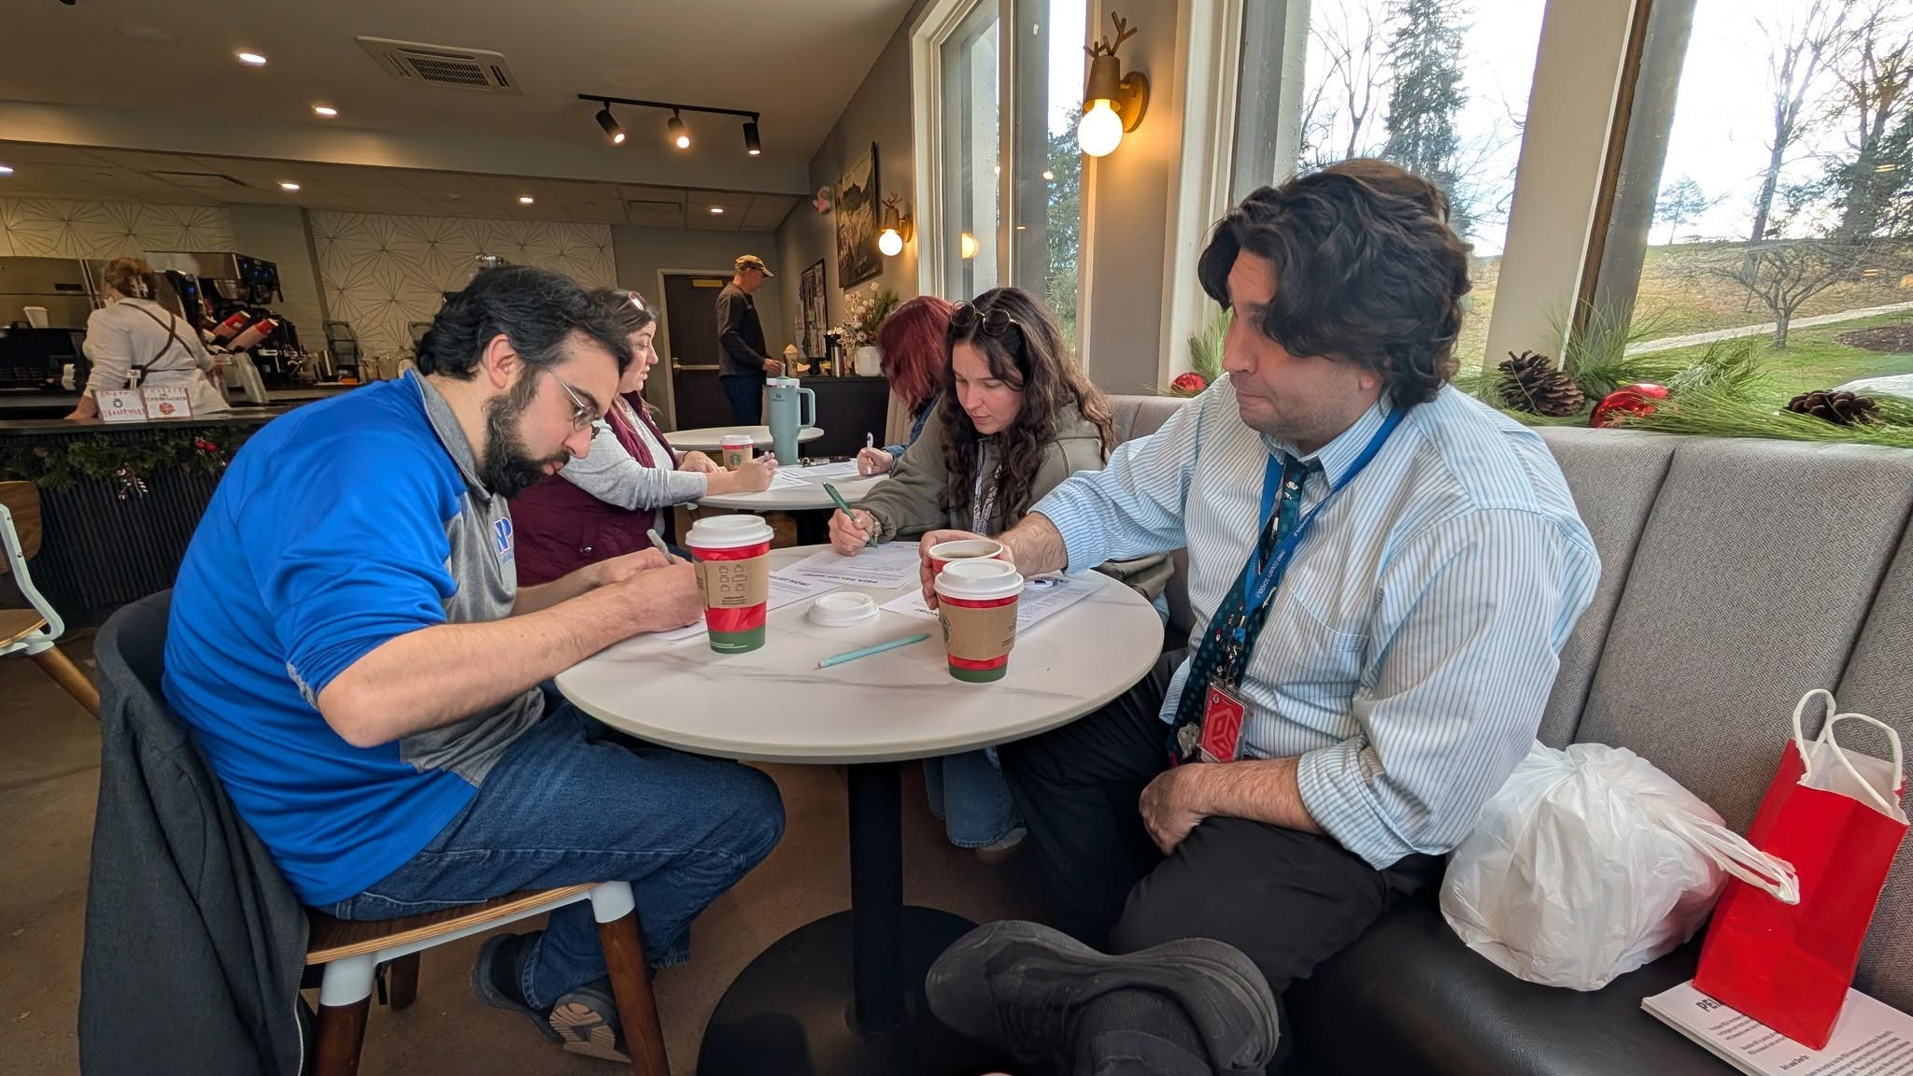
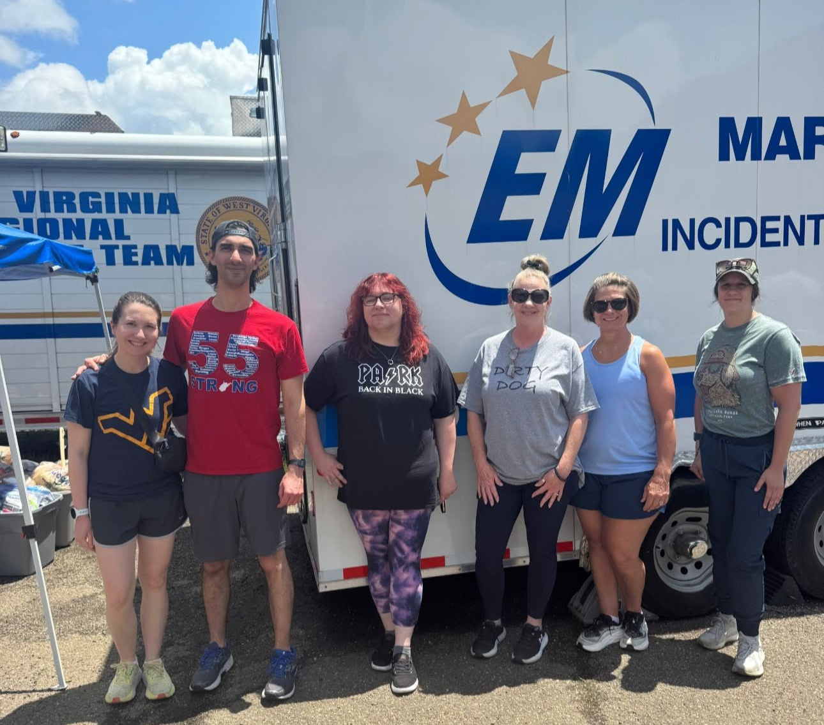
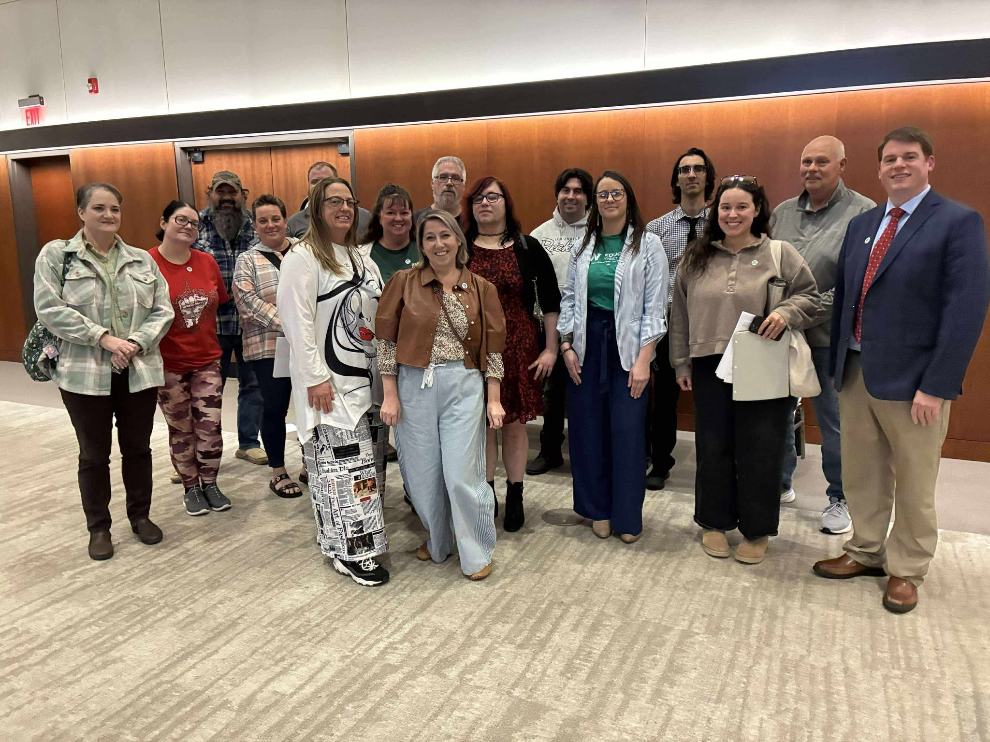
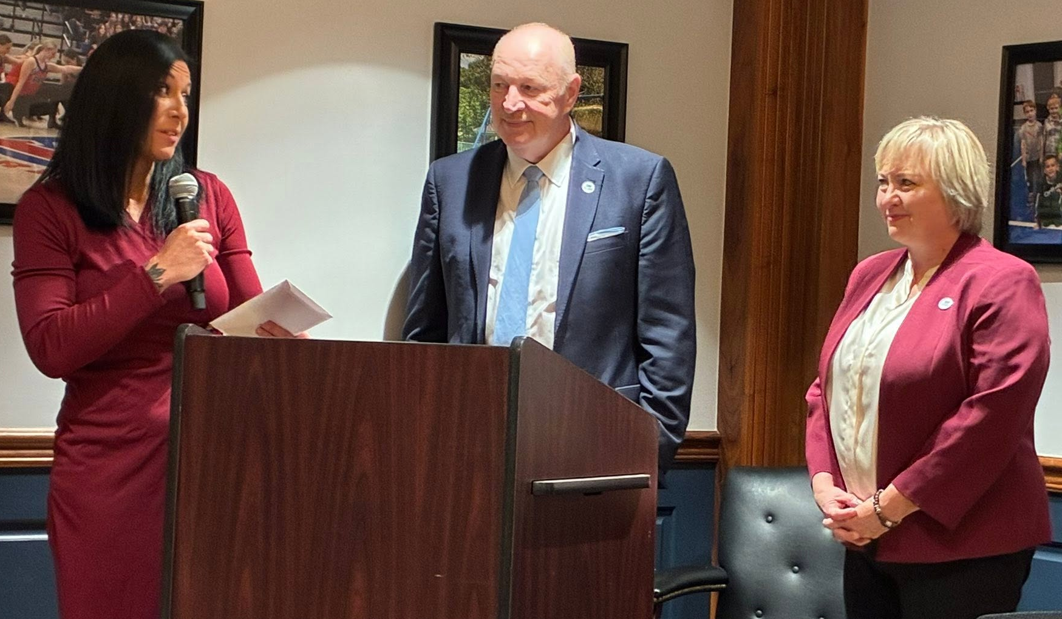
All advocacy and activism is valuable
Sometimes it looks like town halls and forums, sometimes its standing in solidarity, writing postcards, and showing up where our legislators are, sometimes it's volunteering in your community and sometimes is celebrating each other …

Slide 11
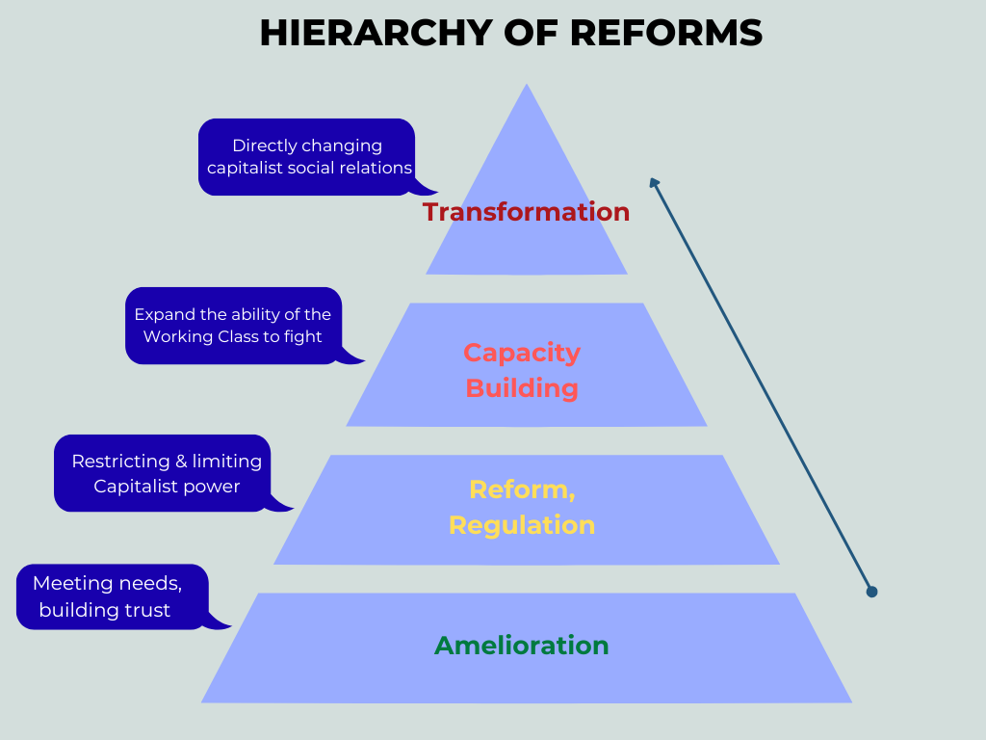
Building Power
Directly changing power dynamics
Expanding members’ abilities to organize
Restricting & limiting administrative power
Meeting needs, building trust

