Slide 1

OVERCOMING BARRIERS
How Education West Virginia-Mercer Fought Back Against an Administration That Tried to Unilaterally Ban Them From Visiting Schools and Secured Protected Worksite Entry Rights under New Board Policy K-08.

Slide 2



THE RISING TENSIONS
May 2024: Friction Begins
September 2024: Member Outcry
Hostility originates at the leadership tier as Mercer County Central Office administration begins exhibiting dismissive and occasionally aggressive behaviors toward MCEA and union leadership.
The friction trickles down to school campuses. Multiple members raise formal concerns regarding unprofessional conduct and heavy-handed actions from certain Central Office administrators.

Slide 3


STANDING UP TO POWER
United Front
On January 20, 2025, members, local, and state leadership pack the Board of Education meeting, establishing the union as a strong, united front.
A Vote of No Confidence
The accumulation of aggressive behavior toward union representatives and structural dismissiveness prompts MCEA to draw a line. In January 2025, MCEA publicly moves to oppose the contract renewal of Superintendent Ed Toman.

Slide 4
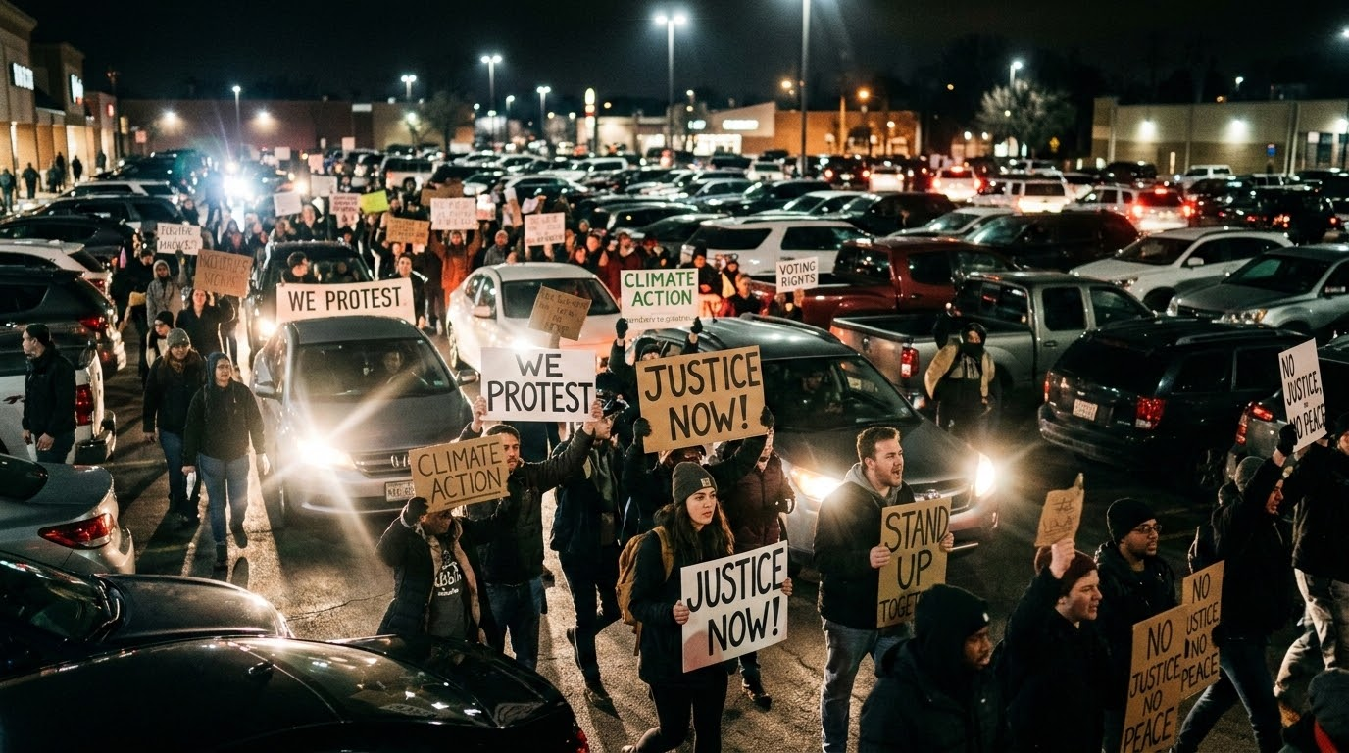
PARK AND HONK PROTEST
February 24, 2025: Mass Action
Local leadership attended the MCBOE meeting while local membership organized en masse in the parking lot.
Members honked their horns throughout the meeting, creating a powerful auditory demonstration of their opposition to Superintendent Toman’s continuing contract.
play_arrow
Watch the Protest Footage
https://www.facebook.com/share/v/1BVePzwUgX/

Slide 5

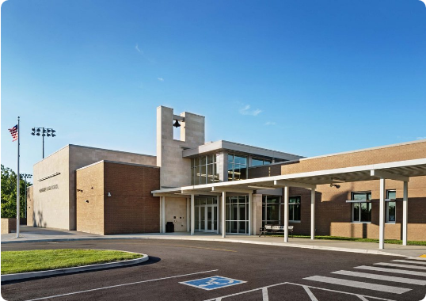
OPENING DAY LOCKOUT
The Campus Ban
In August 2025, Superintendent Toman escalates building restriction tactics. For the annual Opening Day at Bluefield High School (BHS), union organizers are completely locked out of school grounds.
When asked to set up a standard informational table for the merged organization, EWV-Mercer, President Dale Lee is summarily refused permission, establishing a selective, local county union lockout.

Slide 6






SPEAKING OUT
Public Challenge
Combating Overreach
Demanding Action
Dale Lee speaks at sequential board meetings (Aug 25, Sept 8, Sept 22) directly calling out Mercer County's selective, unconstitutional restrictions.
EWV-Mercer mounts strong opposition against Toman's unilateral August 26 memo banning employees from recording disciplinary meetings.
The union demands to enter executive sessions, warning the board that access restrictions and table bans violate fundamental collective representation rights.

Slide 7
THE ROAD TO POLICY
November 2025
February 2026
Dale Lee attends MCBOE work session to hammer out operational disputes.
Carl Lilly critiques the draft. Board tables policy to seek compromises.
August 2025
January 2026
Unilateral recording ban memo & BHS lockout trigger EWV pushback.
Board releases proposed restrictive access policy for public comment.

Slide 8

THE CRITICAL BATTLEGROUND
Access Dimension | Initial Administrative Position | Final K-08 Policy (Approved 5/26/2026)
Union Representation | Locked out, selective bans, no tables | Formally recognized as a legal "Outside Organization"
Physical Access | Banned from campus properties entirely | Permitted to enter school grounds in designated areas
Member Interactions | Dismissive rules, prohibited on school time | Allowed during work hours, duty-free lunches, & planning periods
Non-Member Outreach | Strictly illegal to communicate | Protected contact before/after school and during lunches

Slide 9

UNDERSTANDING POLICY K-08
A Legal & Operational Shield
On May 26, 2026, the Mercer County Board of Education officially adopts Board Policy File K-08, "Advertising, Solicitation, and Fundraising in Schools."
Rather than codifying Toman's complete lockout, Policy K-08 establishes transparent rules that secure union visitation rights for both member and non-member interactions on campus grounds.

Slide 10


THE ADVOCACY TRIUMPH
Guaranteed Right of Entry
This is a major victory for Education West Virginia-Mercer. By organizing, packing public board sessions, and contesting overreach, we have:
Secured a clear, written, legal path for worksite representation.
Guaranteed rights to interact with existing members during workdays.
Preserved critical avenues to organize and connect with non-members.

