Slide 1
Building Power
Education WV
June 23-24, 2026

Slide 2
Power

Slide 3
What is power?

Slide 4
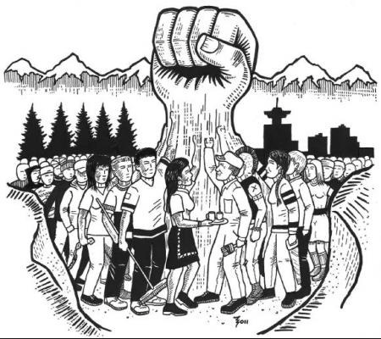
Power is our ability to influence the behavior of others and/or the course of events
4

Slide 5
How do we build local union power?

Slide 6

o
Value of collective power
What story does this drawing tell about unions?

Slide 7
Our power is built on…
Members
High membership and engaged members
Structure
Strong and robust structure, representation system
Issues
Capacity to campaign, mobilize and win on issues

Slide 8
Members
High membership and engaged members

Slide 9

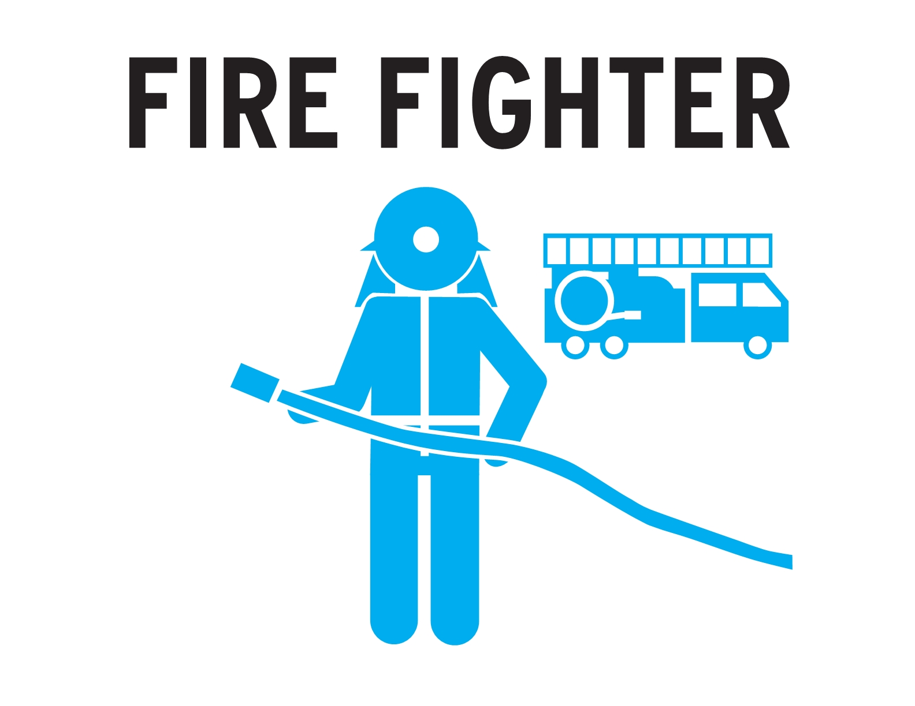
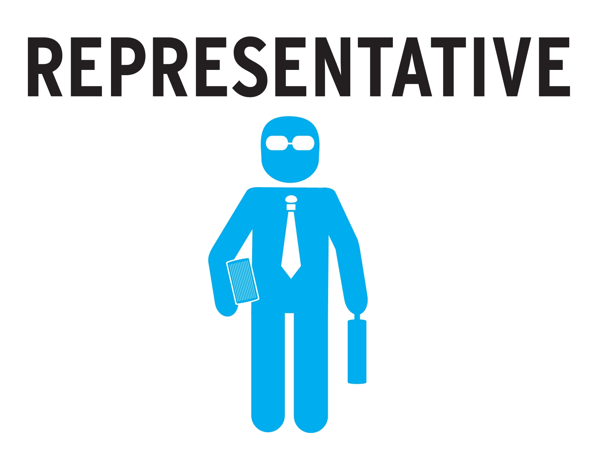
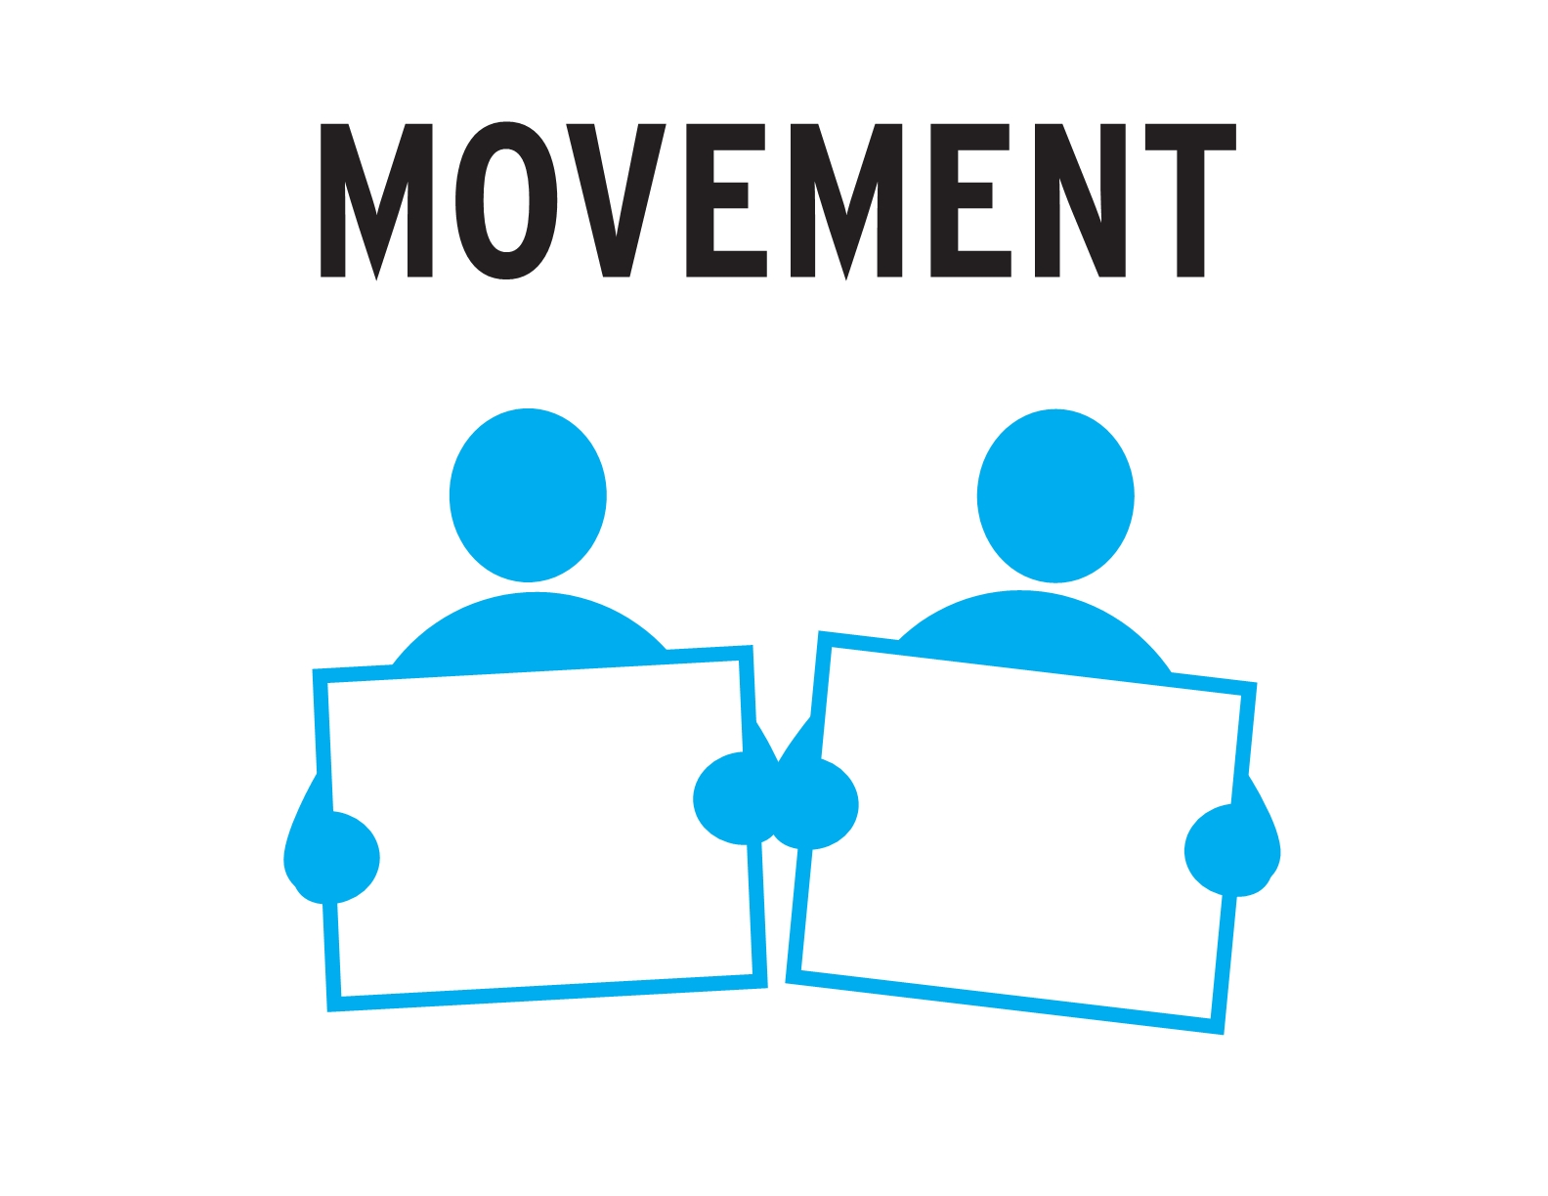
How do our members see our union?
9

Slide 10
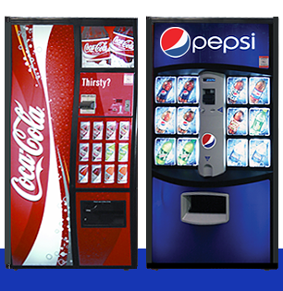
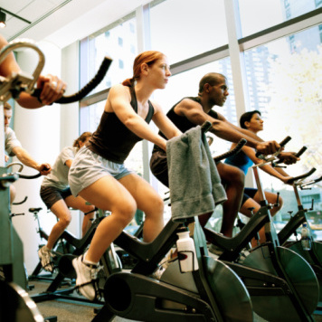
Union membership: what's the analogy?
Transactional/Service
Transformational/Organizing

Slide 11

One-on-one conversations
What is one-on-one? (Also called an organizing conversation)
Why do we have them?

Slide 12
Structure
Strong and robust structure, representation system

Slide 13

We have leaders throughout our structure
A leader is someone who influences the opinions or inspires the actions of other people

Slide 14
Strong structure – one to 10
Worksite leader or activist
Member
Member
Member
Member
Member
Member
Member
Member
Member
Member
The science and the art = realistically, one person can talk to 10 people in a reasonable amount of time

Slide 15
In our structure, how does each role we build an effective, strong union?
Members
Worksite leaders
Executive board
Officers
15

Slide 16
Issues
Capacity to campaign, mobilize and win on issues

Slide 17
There are many issues to organize around – that means many types of campaigns:
Worksite issues
Grievances
Contract campaigns
Statewide issues
Community issues

Slide 18
Why campaigns (issue organizing)?
Build power in our workplace to improve the lives of our members and potential members
Issue organizing engages members, potential members, others
We get better as we go – we learn from each campaign
Makes our union the kind of group people want to join
In campaigns, people step forward as activists and leaders
18

Slide 19
What makes a good organizing issue? It is…
Unifying: brings people together by job classification, work site, shift, across race/gender/age, etc.
Instructive: teaches the value of union, planning, organization, and unity even if immediate victory is not won
Educational: helps members learn new skills and acquire new information and greater understanding
Mobilizing: involves the largest possible number of people
Empowering: gives more workers a greater voice in and control over their work
19
Notes:
(

Slide 20
Identifying organizing issues
What are some examples of worksite issues that you can share?
What are some examples of unit-wide issues that you can share?
What are some examples of community issues that you can share?
What are some examples of state issues that you can share?
In each of these, how were these issues identified?

Slide 21
To organize around an issue - to campaign...
Set goals and objectives
Determine strategies and approaches
Establish tactics

Slide 22
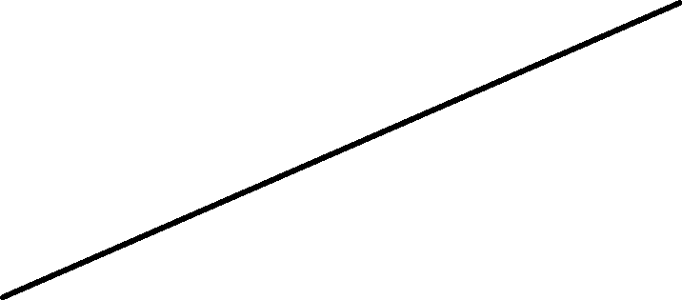
Remember - tactics escalate and build solidarity
March / Rally
Practice
Picketing
Door-to-Door
in Community
“Button Up”
Day
One-on-Ones
22

Slide 23
Plan your campaign
Select your issue
Establish goal and objectives
Plan a campaign to achieve one objective
Establish the phases of your campaign
Choose the strategies, tactics and structure tests for each phase
Determine how you will measure your success
Decide who does what and resources that you'll need

Slide 24
Closing

Slide 25
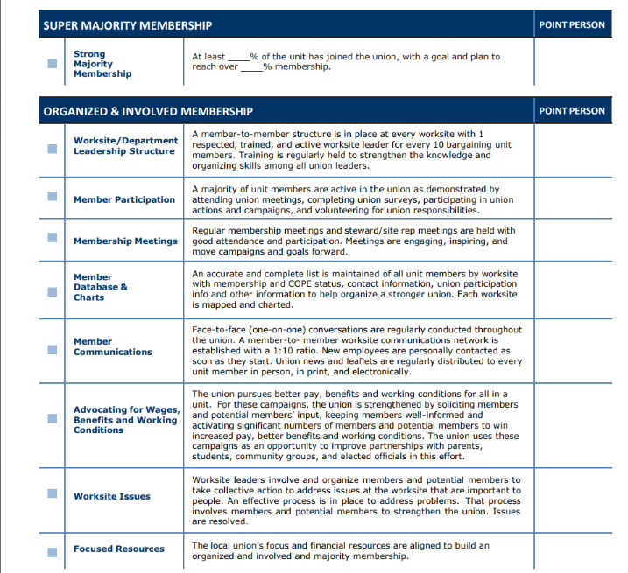
Inventory of a strong union
See handout

Slide 26
And remember, our power is built on…
Members
High membership and engaged members
Structure
Strong and robust structure, representation system
Issues
Capacity to campaign, mobilize and win on issues

