Slide 1
Activists Academy
Presidents and Vice Presidents
Kym Randolph and Heather Hutchens
June 22, 2026

Slide 2
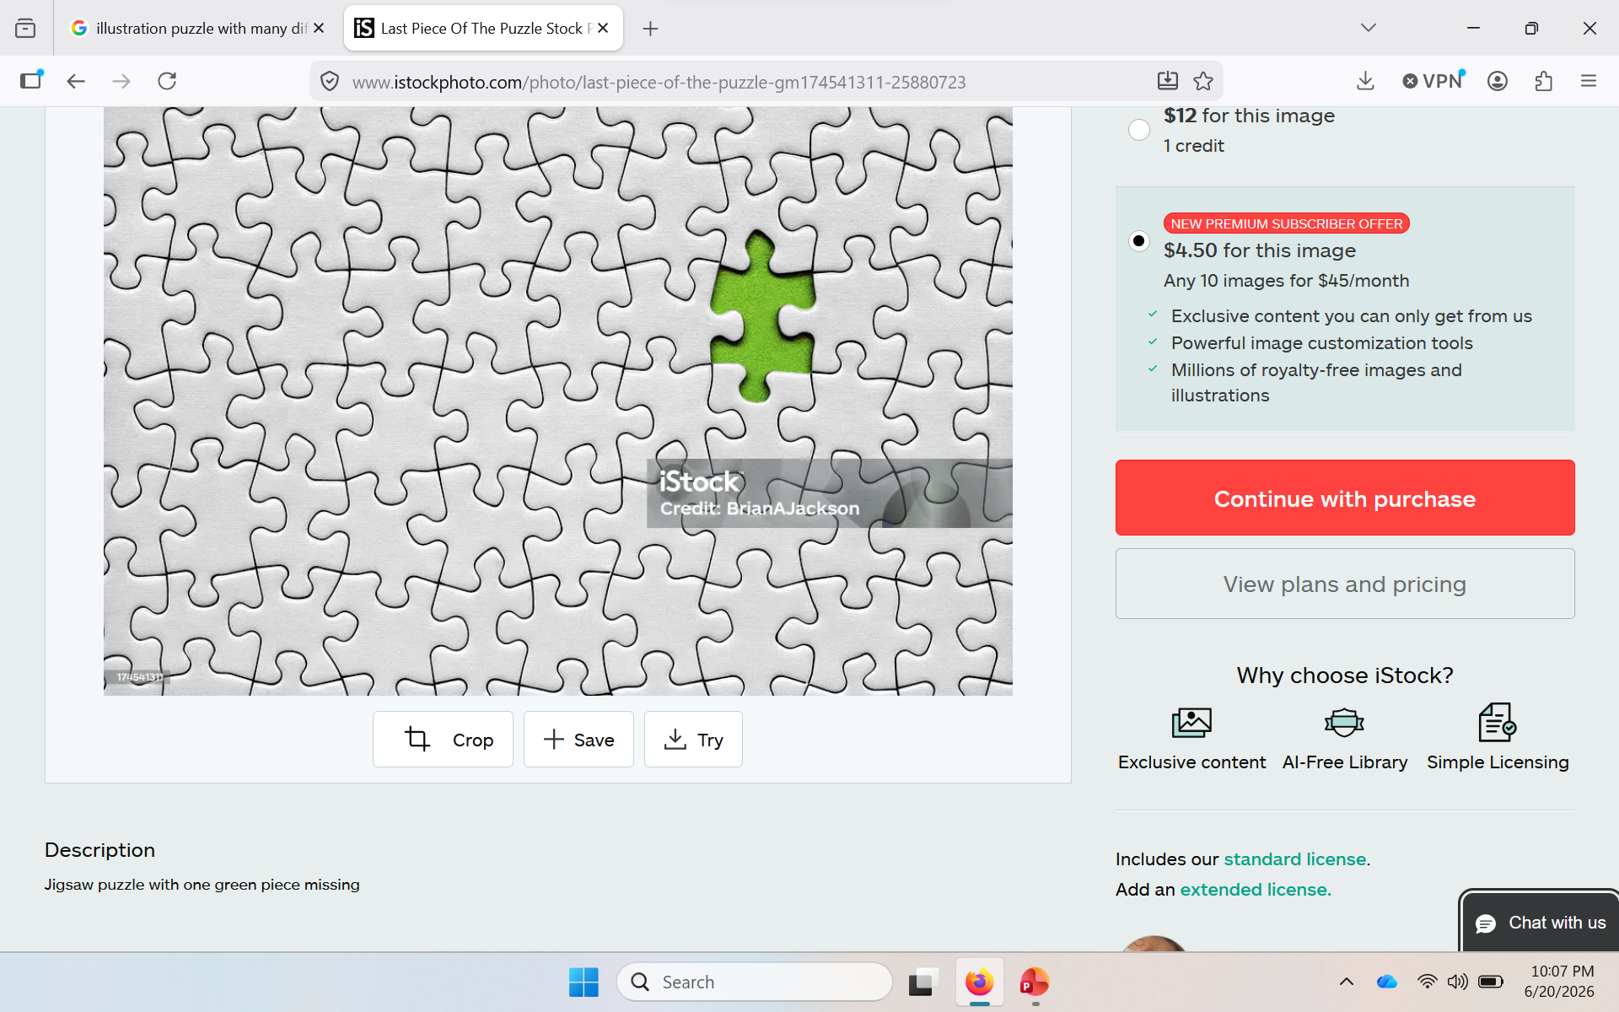

Slide 3
Merging of locals
Fall workshops on chartering locals and getting business running
23 locals have been chartered by the nationals
Next chartering submissions will be the last part of July
Next opportunity will be in early October
Dale, Kristie, staff are all willing to assist in the process
If you are not chartered this summer, we cannot collect any local dues from you members for the 2026-27 school year.

Slide 4
Strength comes from locals
All dependent on each other
Various stages of health
  Triathlons to life-support
All of us are only as healthy as our weakest local
Get everyone healthy and operating in a good space

Slide 5
Your local is a business
Federal and state regulations
  Department of Labor, IRS, Secretary of State, courts
  Filings that have to be made
  Elections that are regulated
  Finances that must be handled properly
    Budget that reflects you goals and objectives
    Appropriate use of member dues dollars
    Non-profit without obligations. Money in money out.
  As the leader, it is your responsibility to make sure your local is in compliance
Constitution and Bylaws

Slide 6
What are the characteristics of a healthy local?
Goals and objectives
Doing your own things
Multi-dimensional
Leadership structure
Leaders known to members
Regular meetings
Offerings for members
Good communication system
for reps and members
Functioning reps in every location
Advocate for local issues
Participation outside of leaders
High membership
Know issues of your members and work on addressing them
Challenge super and board when needed

Slide 7
Three priority items
Building Reps
Communication
Multiples at each site
Functioning – trained in what to do, come to meetings, have conversations with member/non, keep you informed
Building Reps are the most important people in your local.
  July 28 – Morgantown
  July 30 - Charleston
More than just business meetings
How to communicate
  Reps/members/non-members/public/supt/board/parents
  Use your reps
  Emails/announcement
  Building meetings (10-minute mtgs)
  Local news
  Paper/flyers/postcards
  Social media

Slide 8
Engaging members
As you plan for the coming year, try to emphasize activities and objectives that will appeal and engage more members.
What can your local do to appeal to a broader cross section of members and non-members
  Activism
  Charitable/community effort
  political
  Improving teaching

Slide 9
During the afternoon general session
State Superintendent Blatt - discussion
Establishing local PACs
Back to School
Payment schedules and types of payments

Slide 10
Questions???

